Slide 1


Big Data Visualization Using TABLEAU
-Sumati Kulkarni
Notes:
Hello everyone, I am Sumati Kulkarni and Today I will be presenting on Big Data Visualization using Tableau
Topics I am going to cover today

Slide 2


OUTLINE
Introduction to Tableau
Connecting to data
Data
Filters
Data Extracts
Data Transformations
Data Cleaning
Splitting
Pivoting
Merging
Data Integration
Data Analytics
Mapping Data
Creating new maps using MapBox

Slide 3
1
Introduction to Tableau

Slide 4


WHAT IS TABLEAU?
We have to answer two important questions:
WHAT IS DATA VISUALIZATION?
WHY IS DATA VISUALIZATION IMPORTANT?
Notes:
So what is data visualization

Slide 5
WHAT IS DATA VISUALIZATION?
Data visualization is the process of describing information through visual rendering.
Notes:
It is a graphical representation of data using visual elements to understand trend or pattern

Slide 6
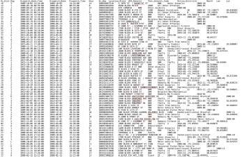
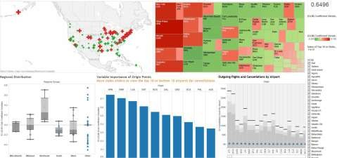
WHAT IS DATA VISUALIZATION?
Notes:
Here you can see if given a flat file, it gives no meaning
Where as the graphs give geographical, quantitative or patterns which help us analyze data
Why is data visualization so important?

Slide 7
WHY IS DATA VISUALIZATION IMPORTANT?
Technological advances have made data visualization more
prevalent and powerful than ever before.
Businesses purpose.
Notes:
Visualizations helps in
Absorbing information
Analyzing patterns
Taking fast actions on emerging trends
Here comes Tableau software

Slide 8
WHAT IS TABLEAU?
Tableau is groundbreaking data visualization software created by Tableau Software.
Tableau connects easily to nearly any data source
Tableau allows for instantaneous insight by transforming data into
interactive visualizations called dashboards.
Notes:
Tableau is a visualization software
It has a variety of data sources that it can connect to
It allows data transformation and interactive data visualizations
So how Tableau connects data to make these visualizations

Slide 9
2
Connecting to Data

Slide 10
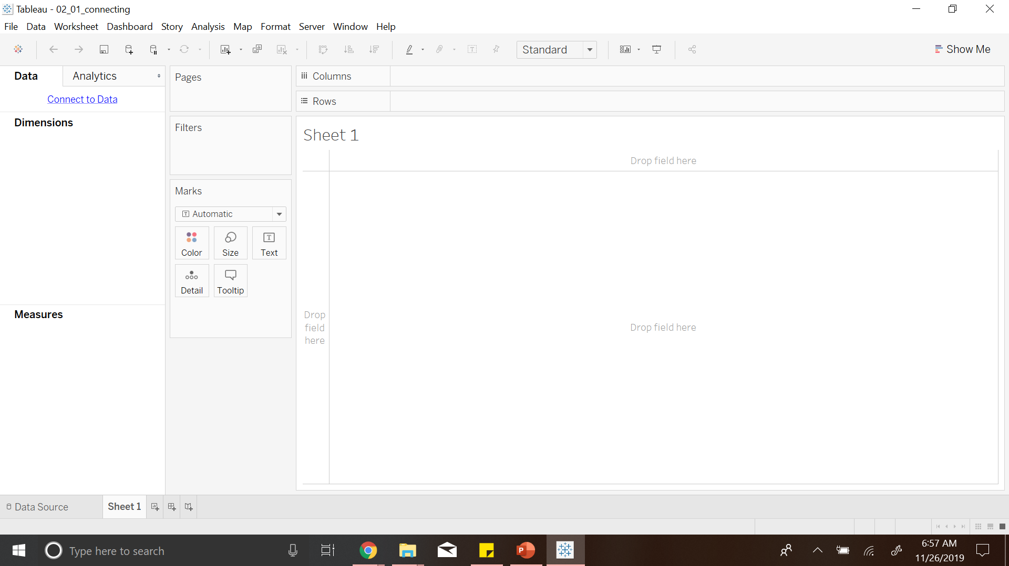
Notes:
There is connect to Data on the left
Which leads to various datasources

Slide 11
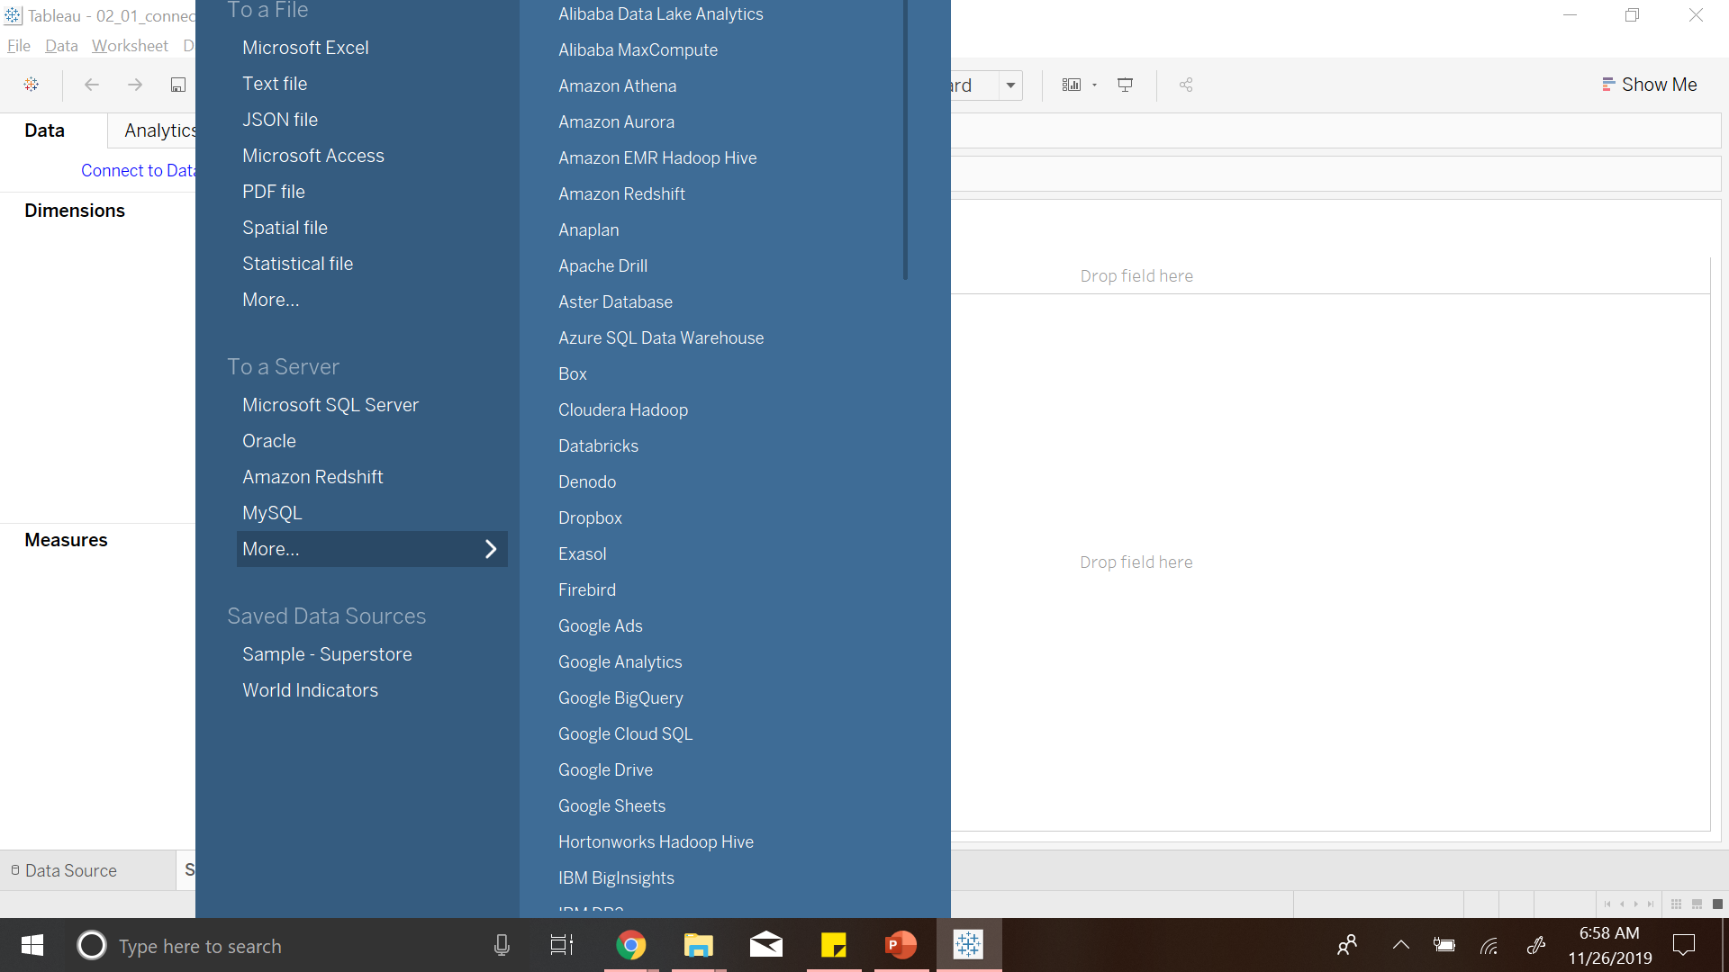
Notes:
I will be connecting to Excel files

Slide 12
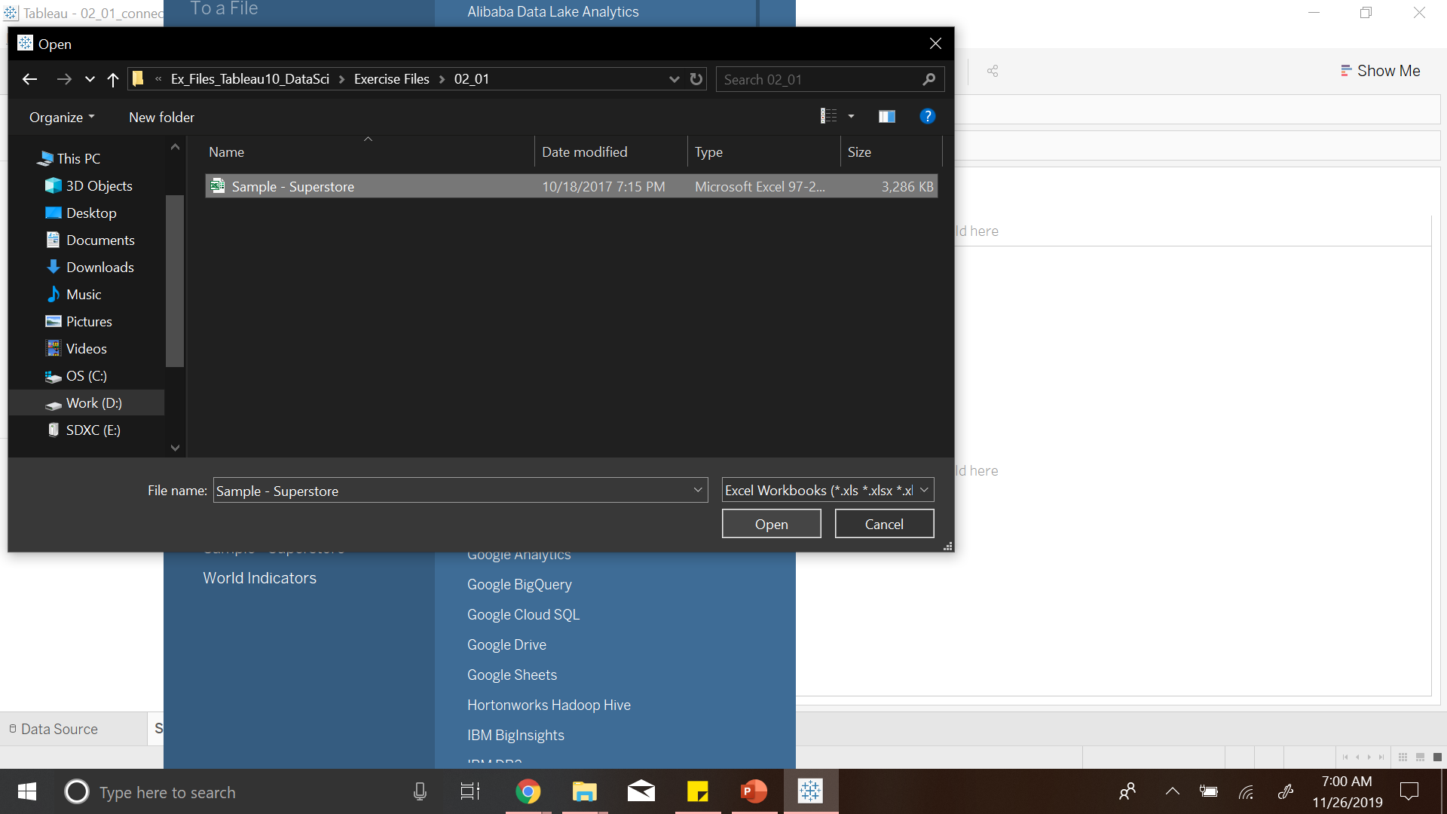

Slide 13
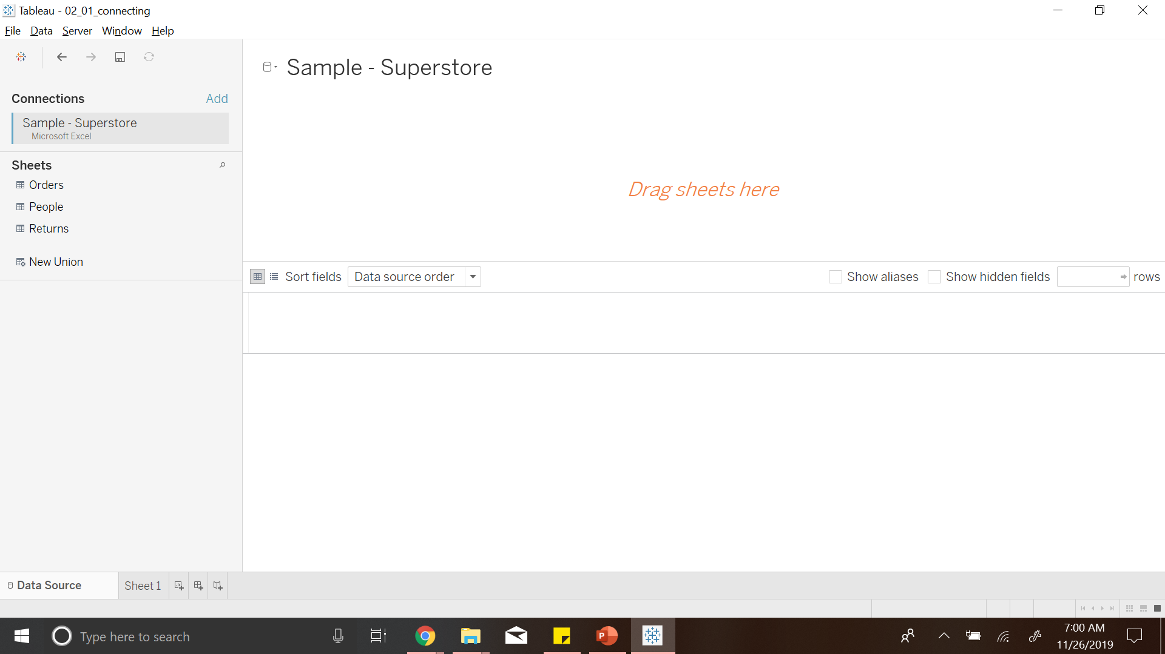
Notes:
We have sales data with three sheets
Orders
People
Returns

Slide 14
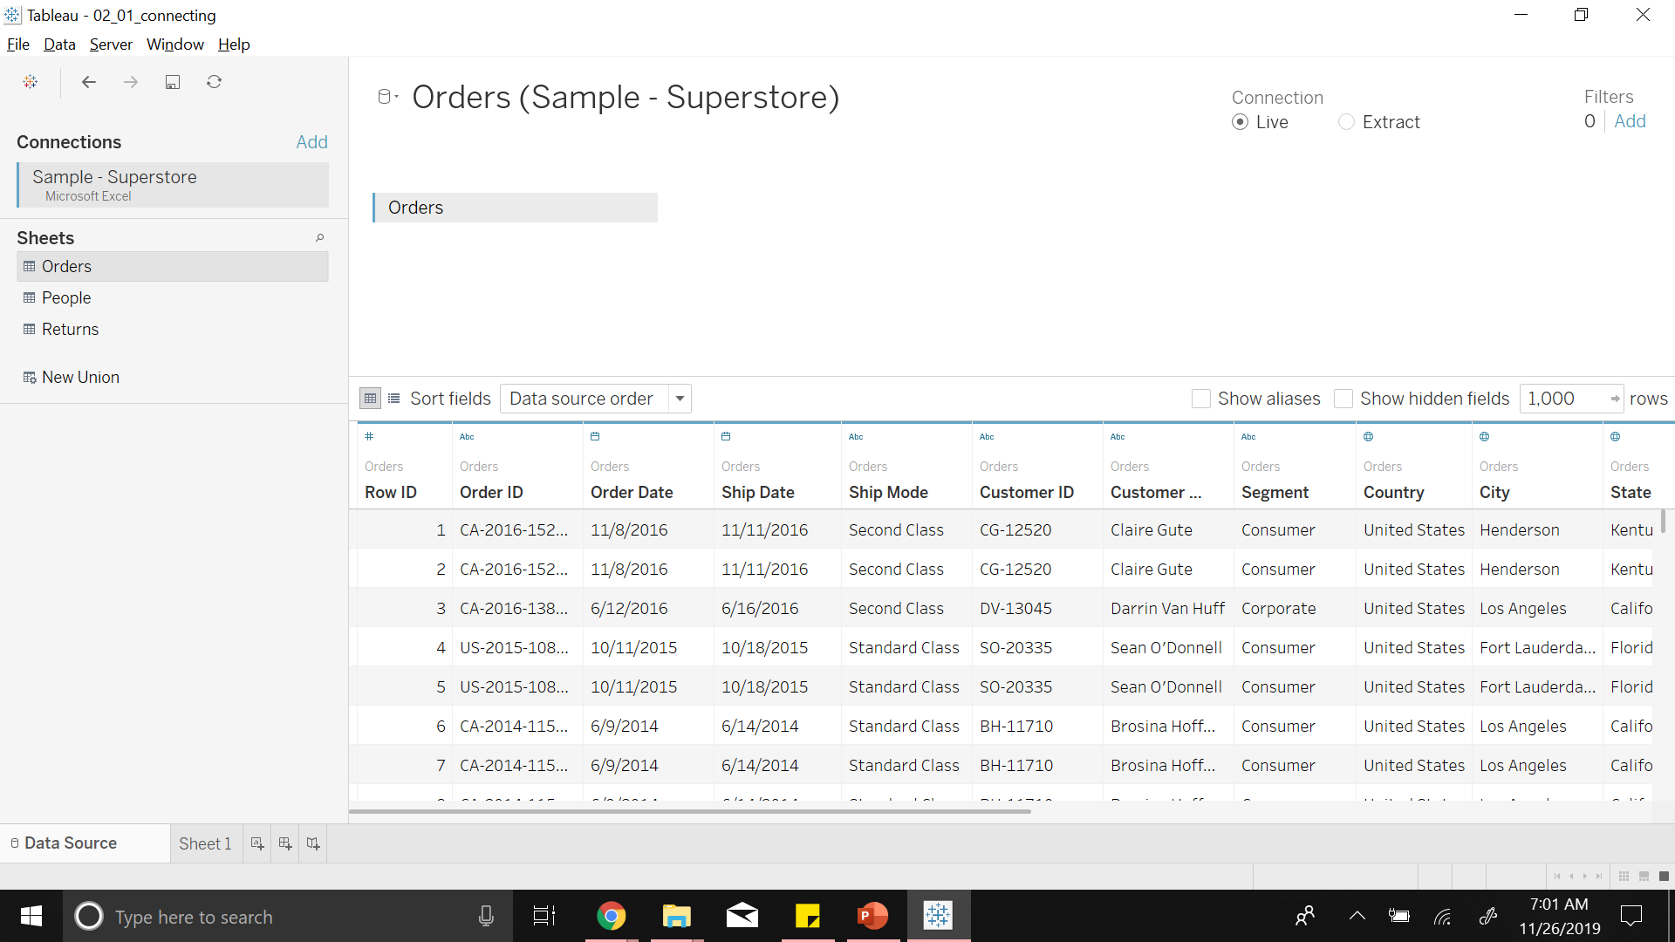

Slide 15
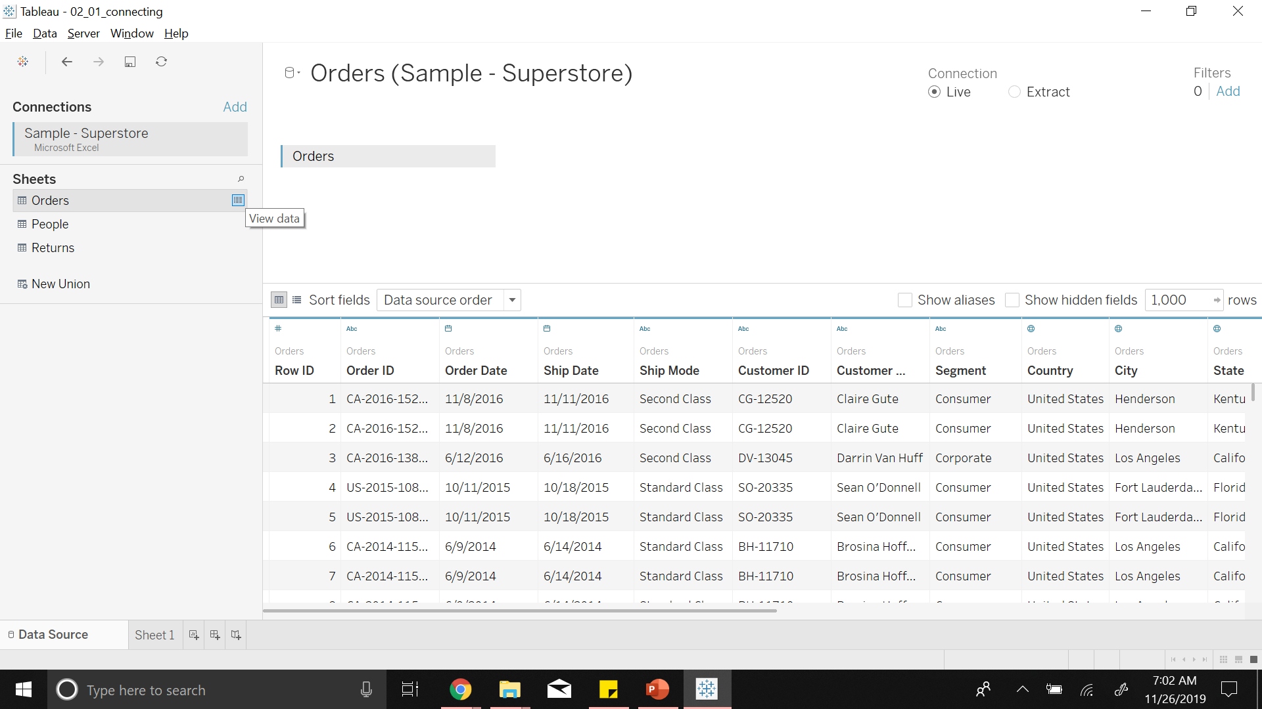

Slide 16
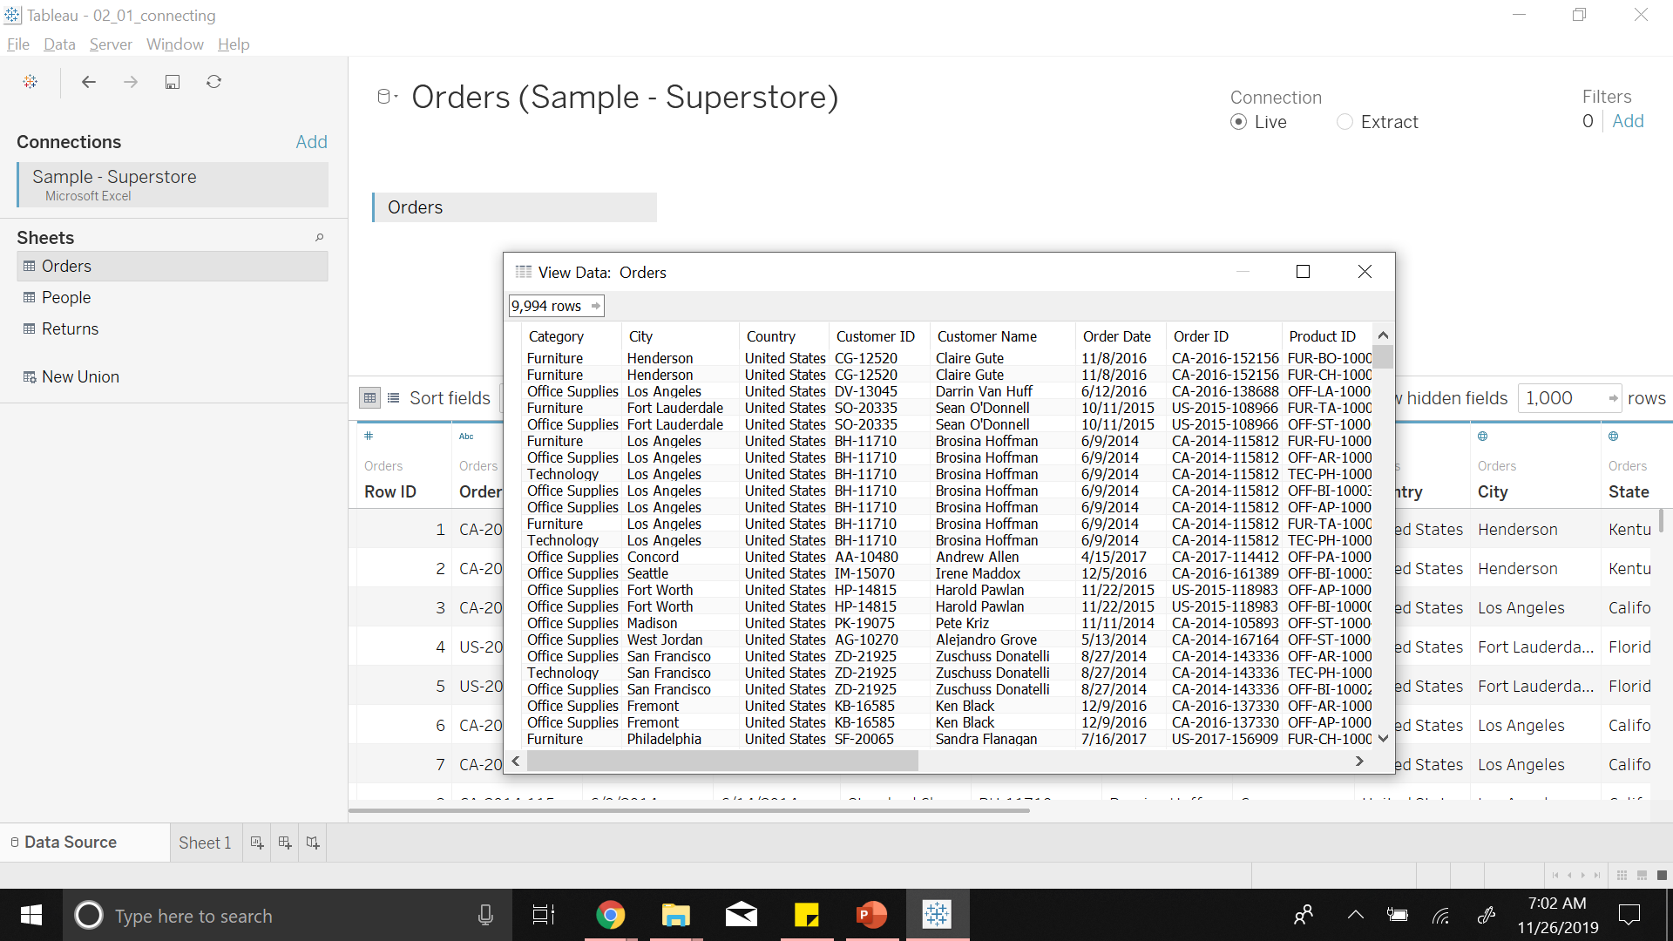
Notes:
Now lets look at how Tableau interprets data

Slide 17
3
Data
Notes:
Data can be either discrete or continuous value

Slide 18
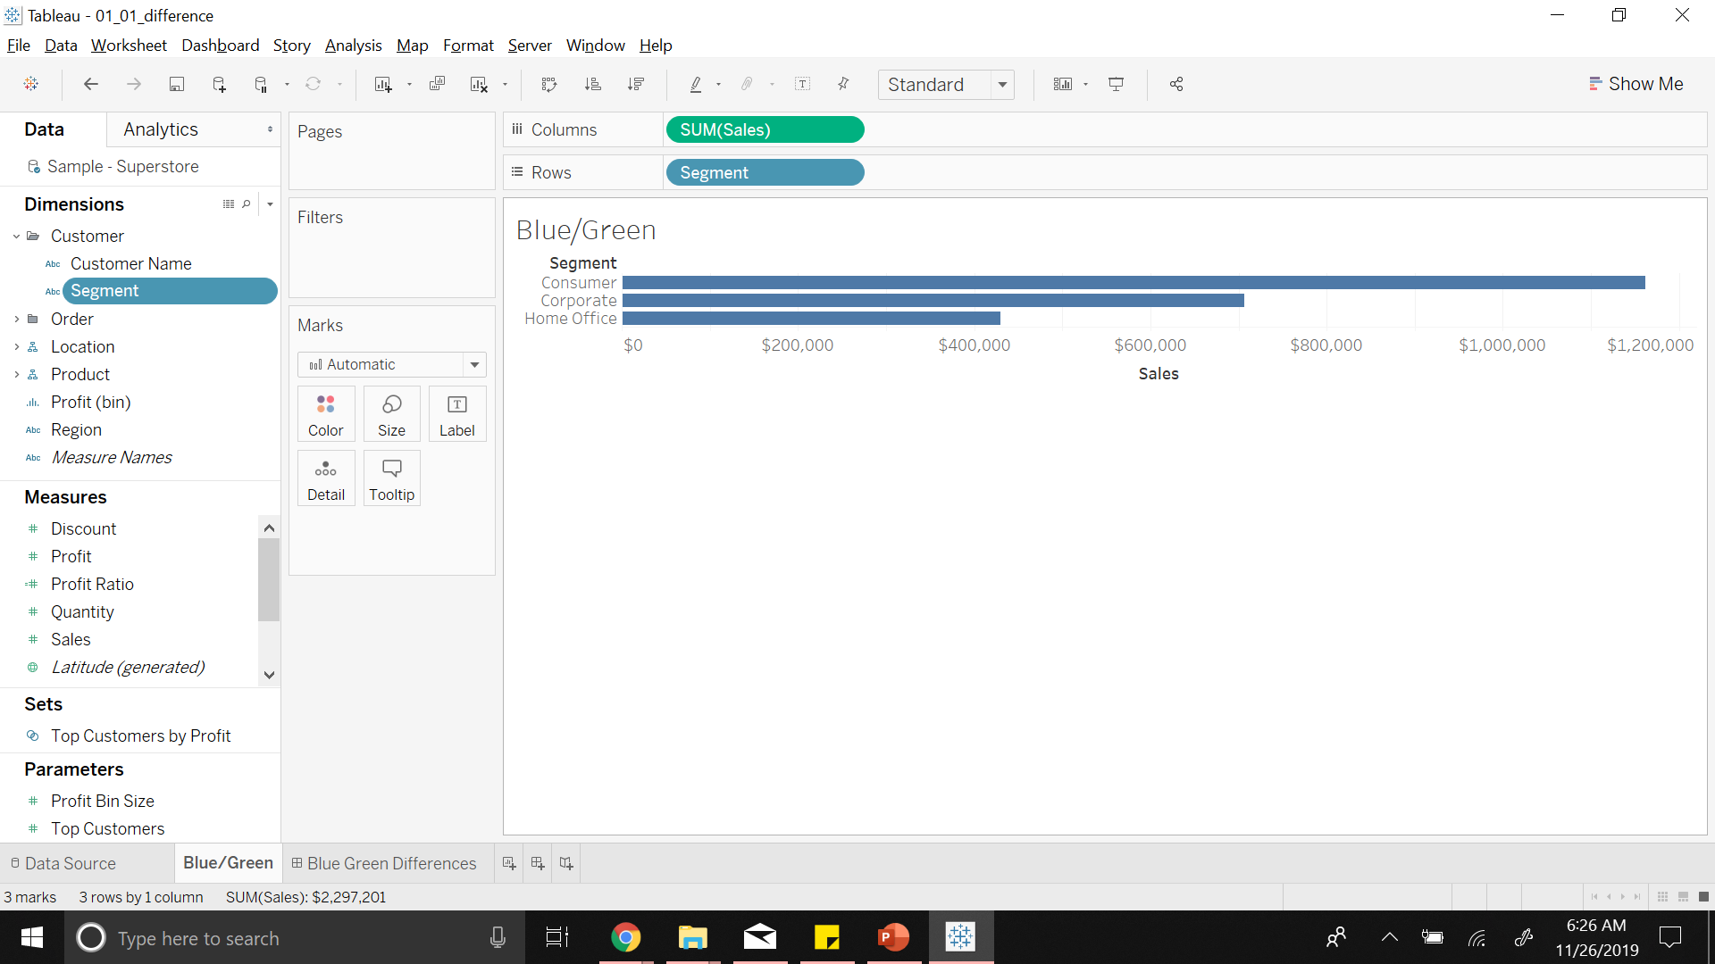
Notes:
Tableau identifies
Discrete – Blue (Segment)
Continuous – Green (Sales – range of values)

Slide 19
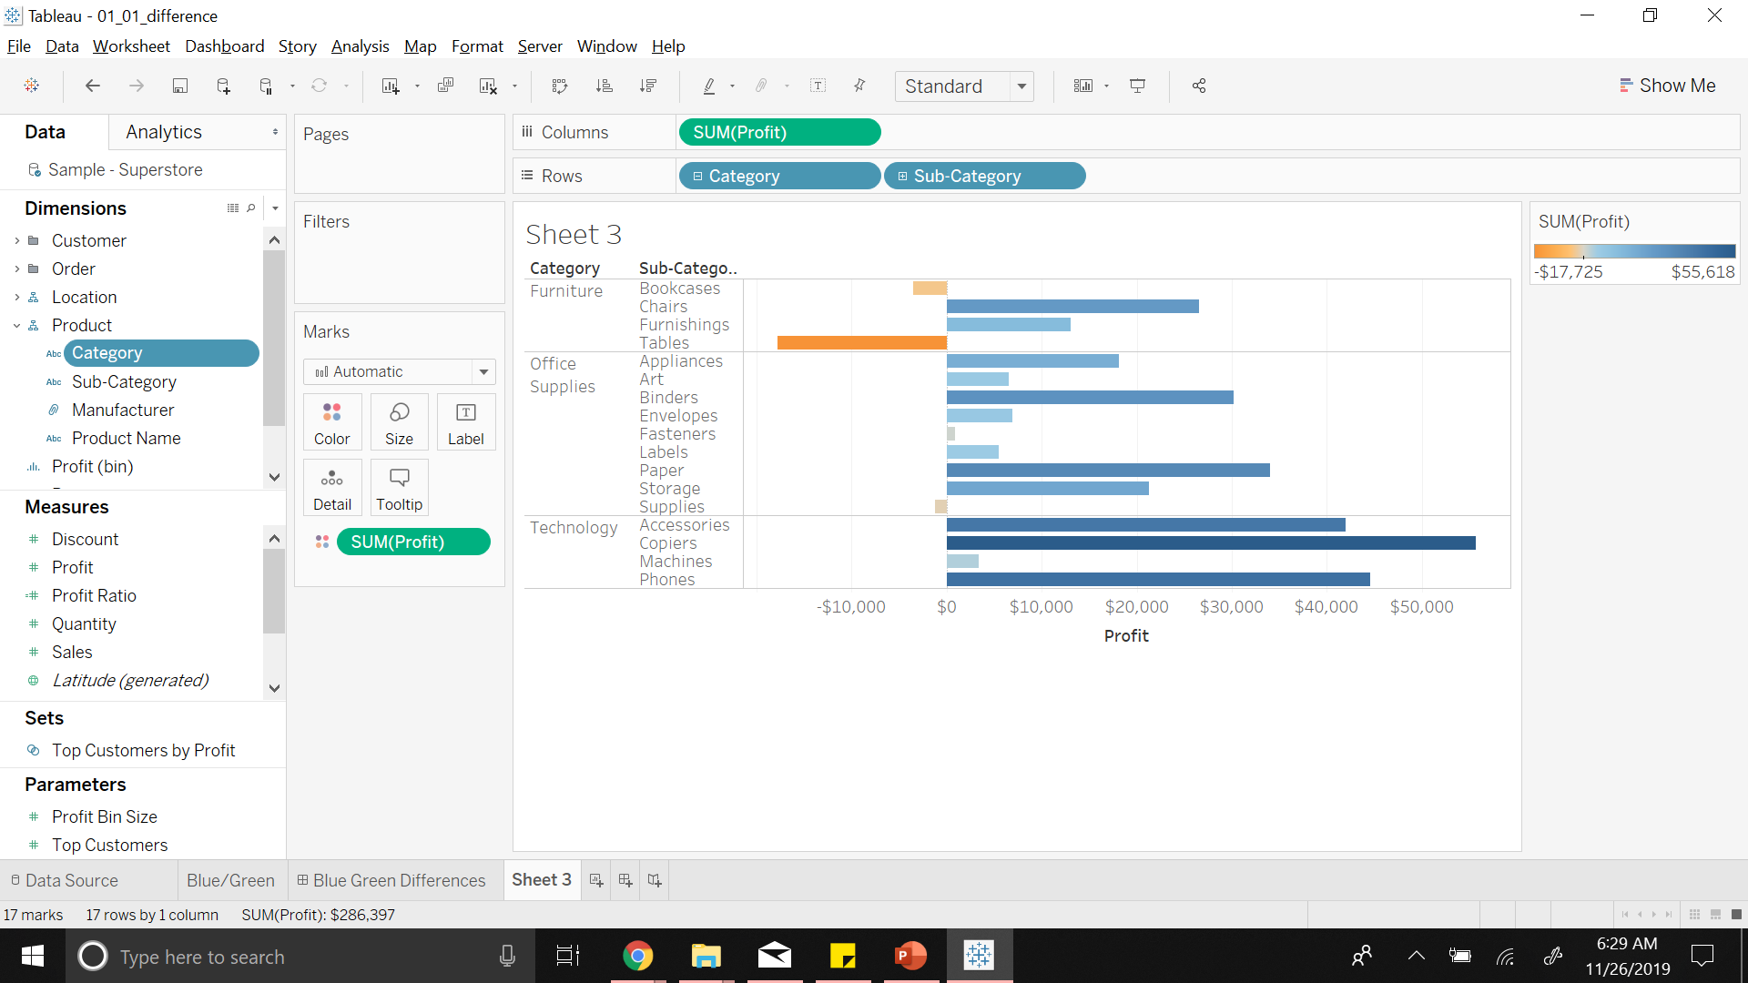
Notes:
Profit is a range (can be –ve to +ve)
Can also have sub categories

Slide 20
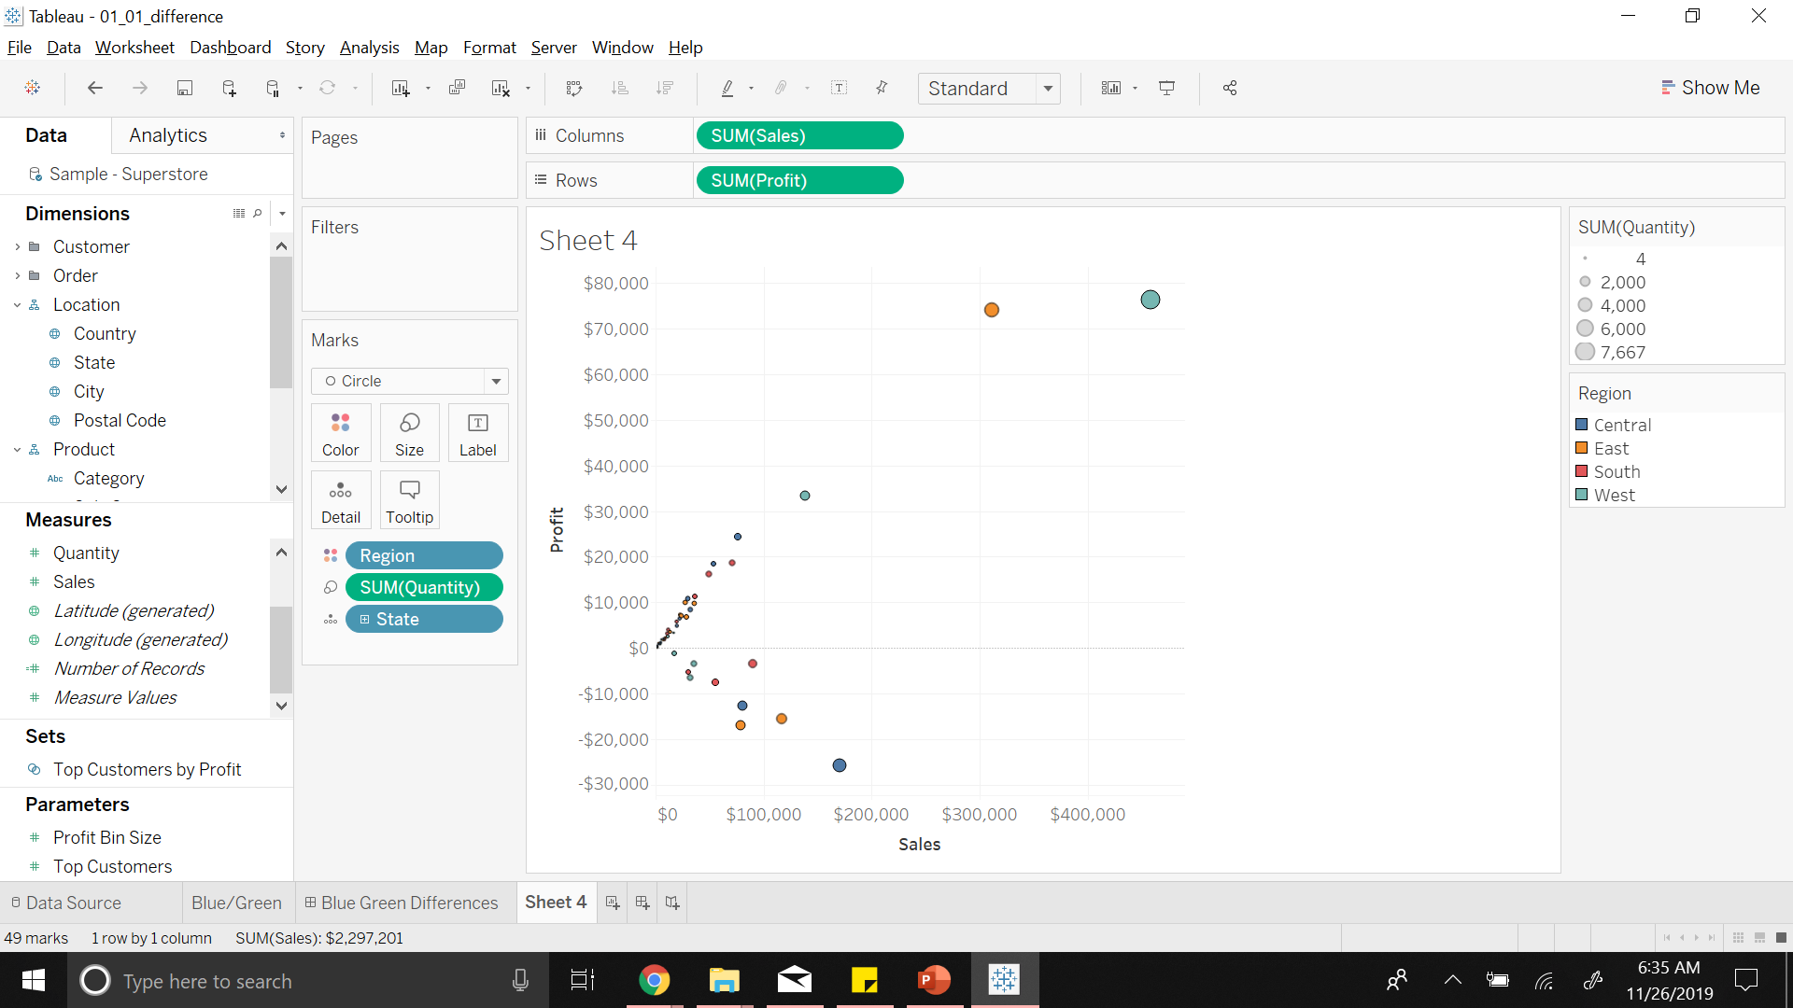
Notes:
Scatter Plot where both are continuous value
Region is a Discrete value and i.e identified by different colors

Slide 21
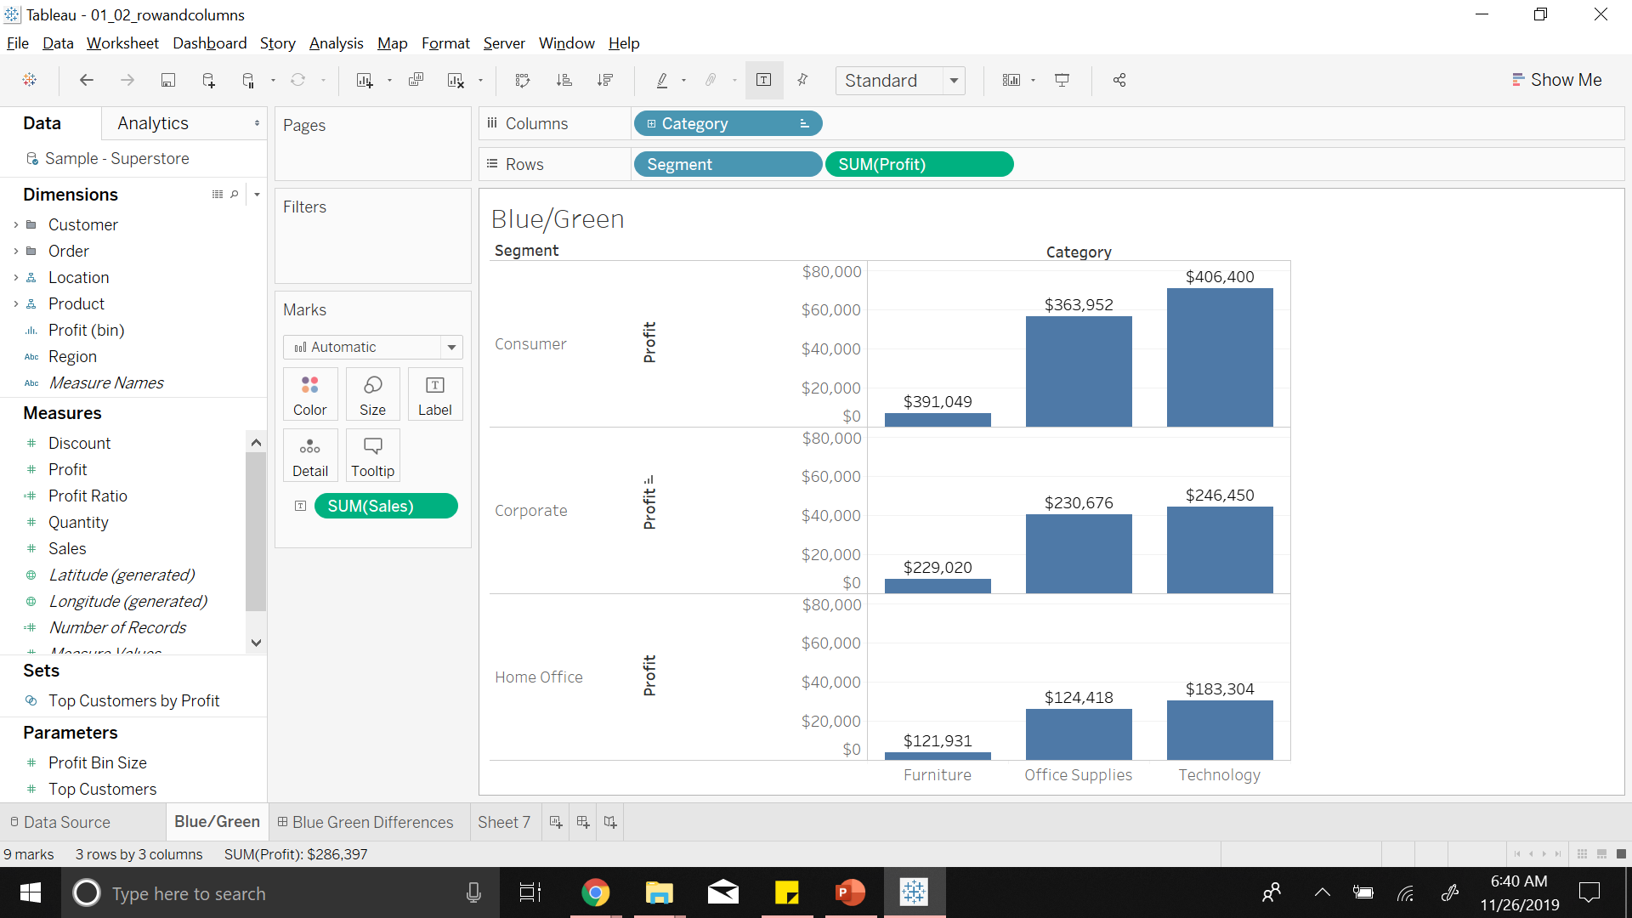
Notes:
Bar chart of Sales for different categories showing the profits

Slide 22
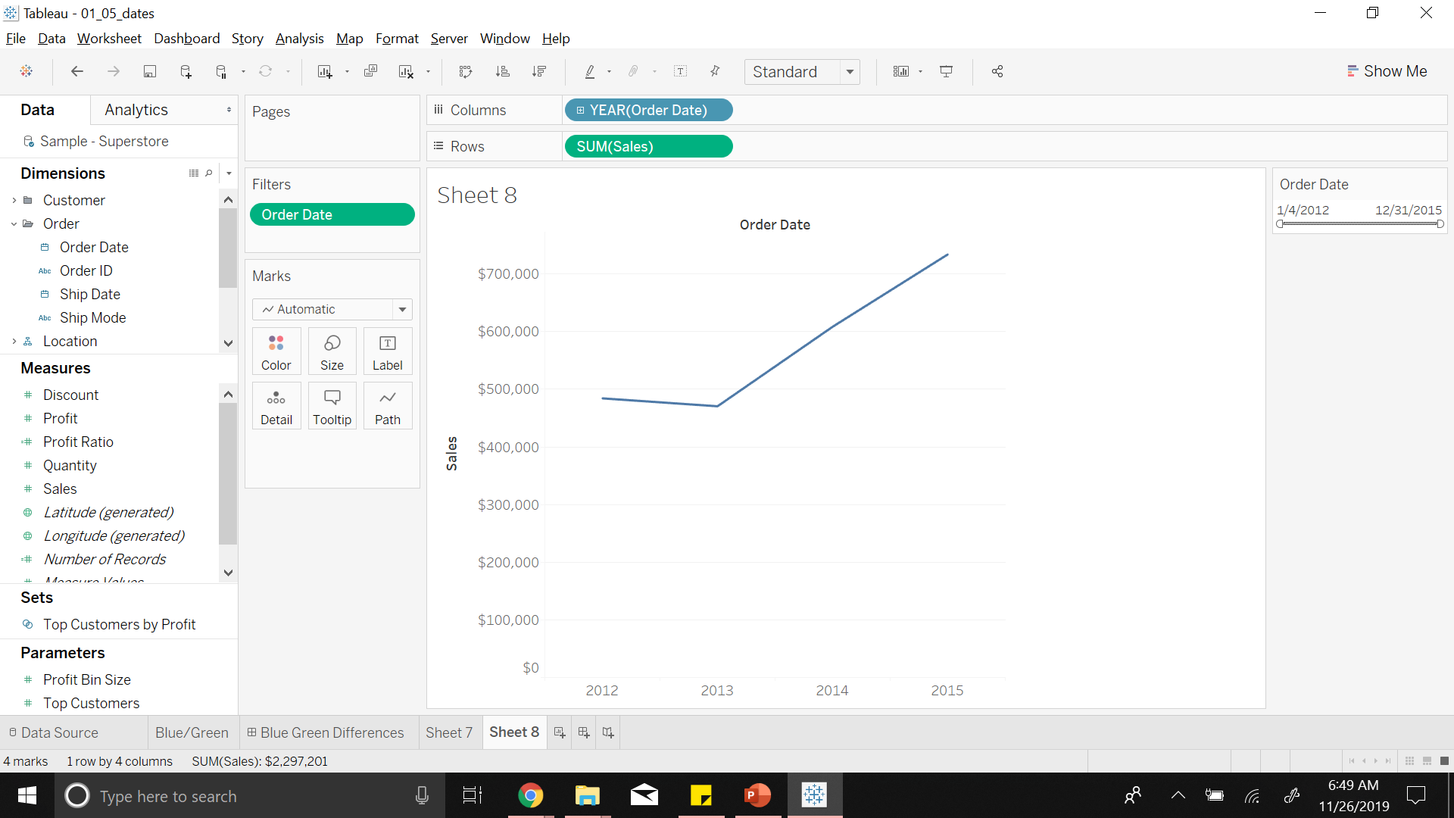
Notes:
Range of sales mapped on to range of order date

Slide 23
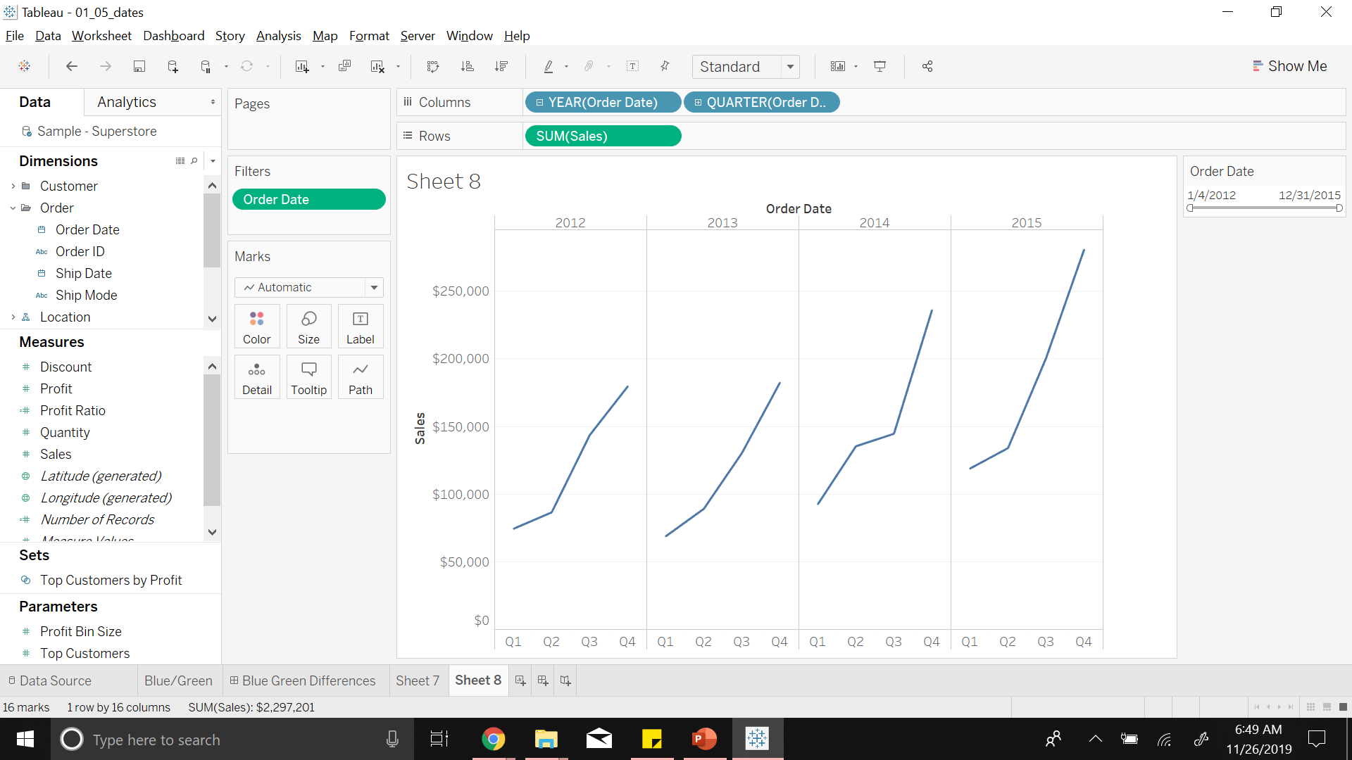
Notes:
We can split the year data into quarters
Can be further analyzed for moths, weeks, etc

Slide 24
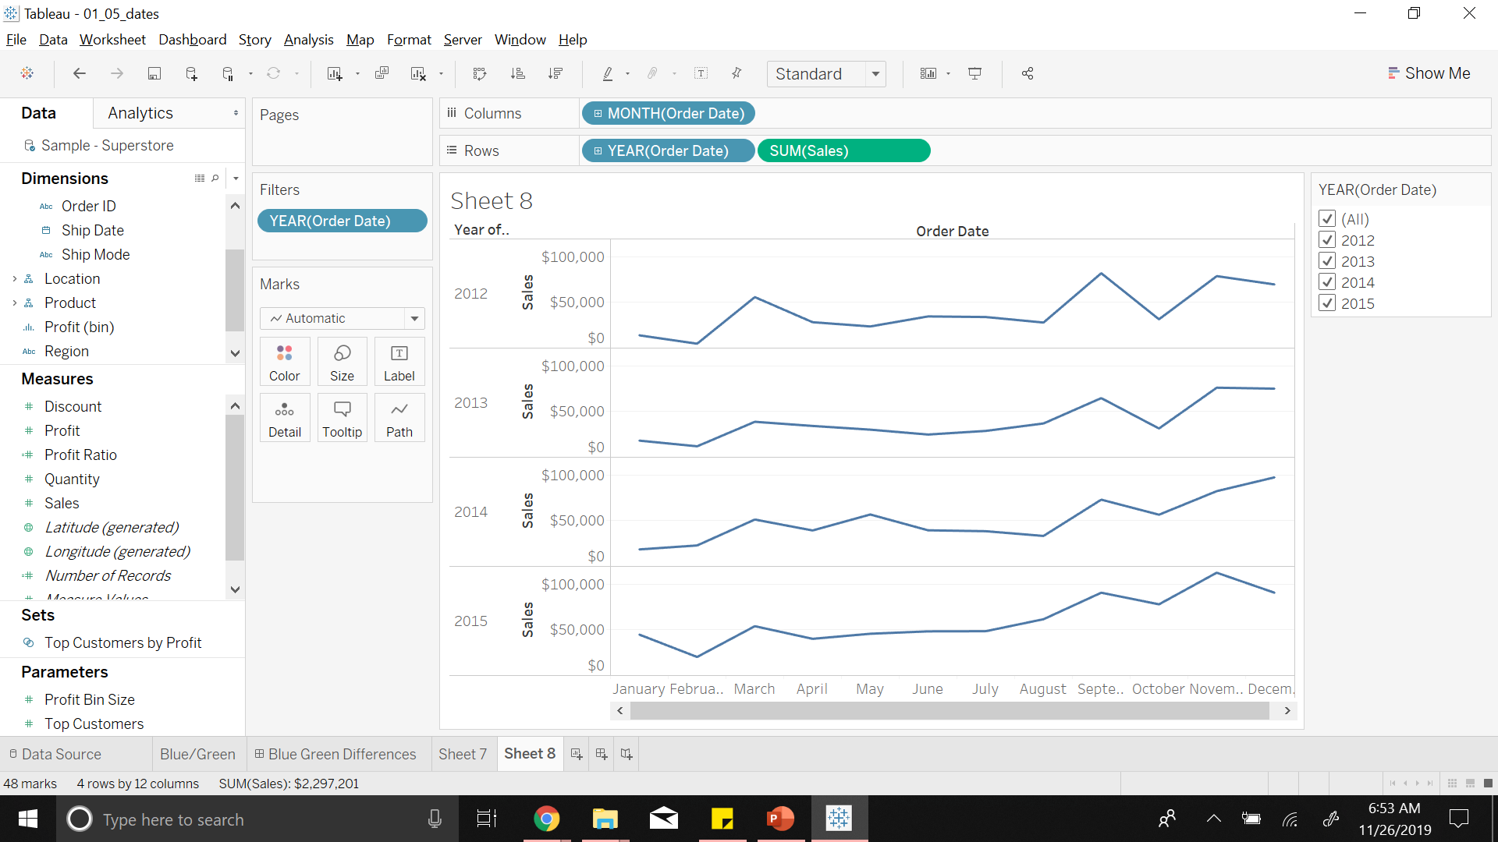
Notes:
We can also see trends of sales over time

Slide 25
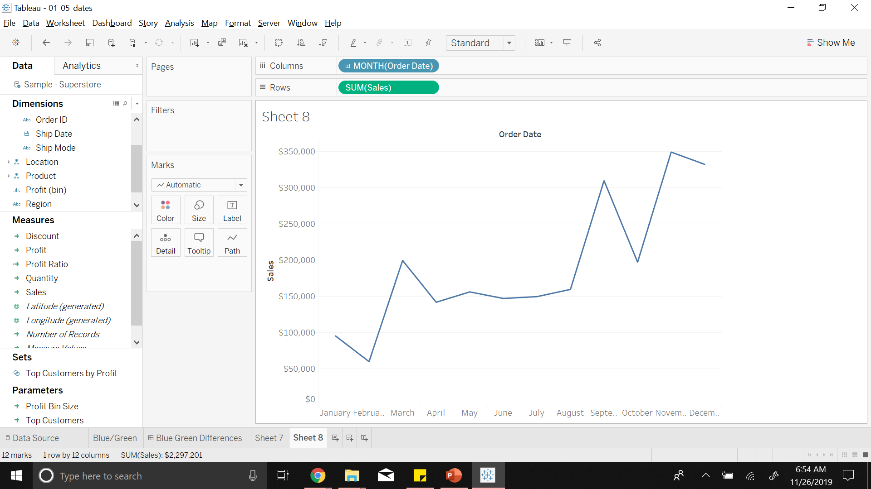
Notes:
Now we will further want to know how to filter data wrt regions.
Tableau helps us to filter data and look at the values closely for analysis
By providing filters

Slide 26
3
Data
Filters

Slide 27
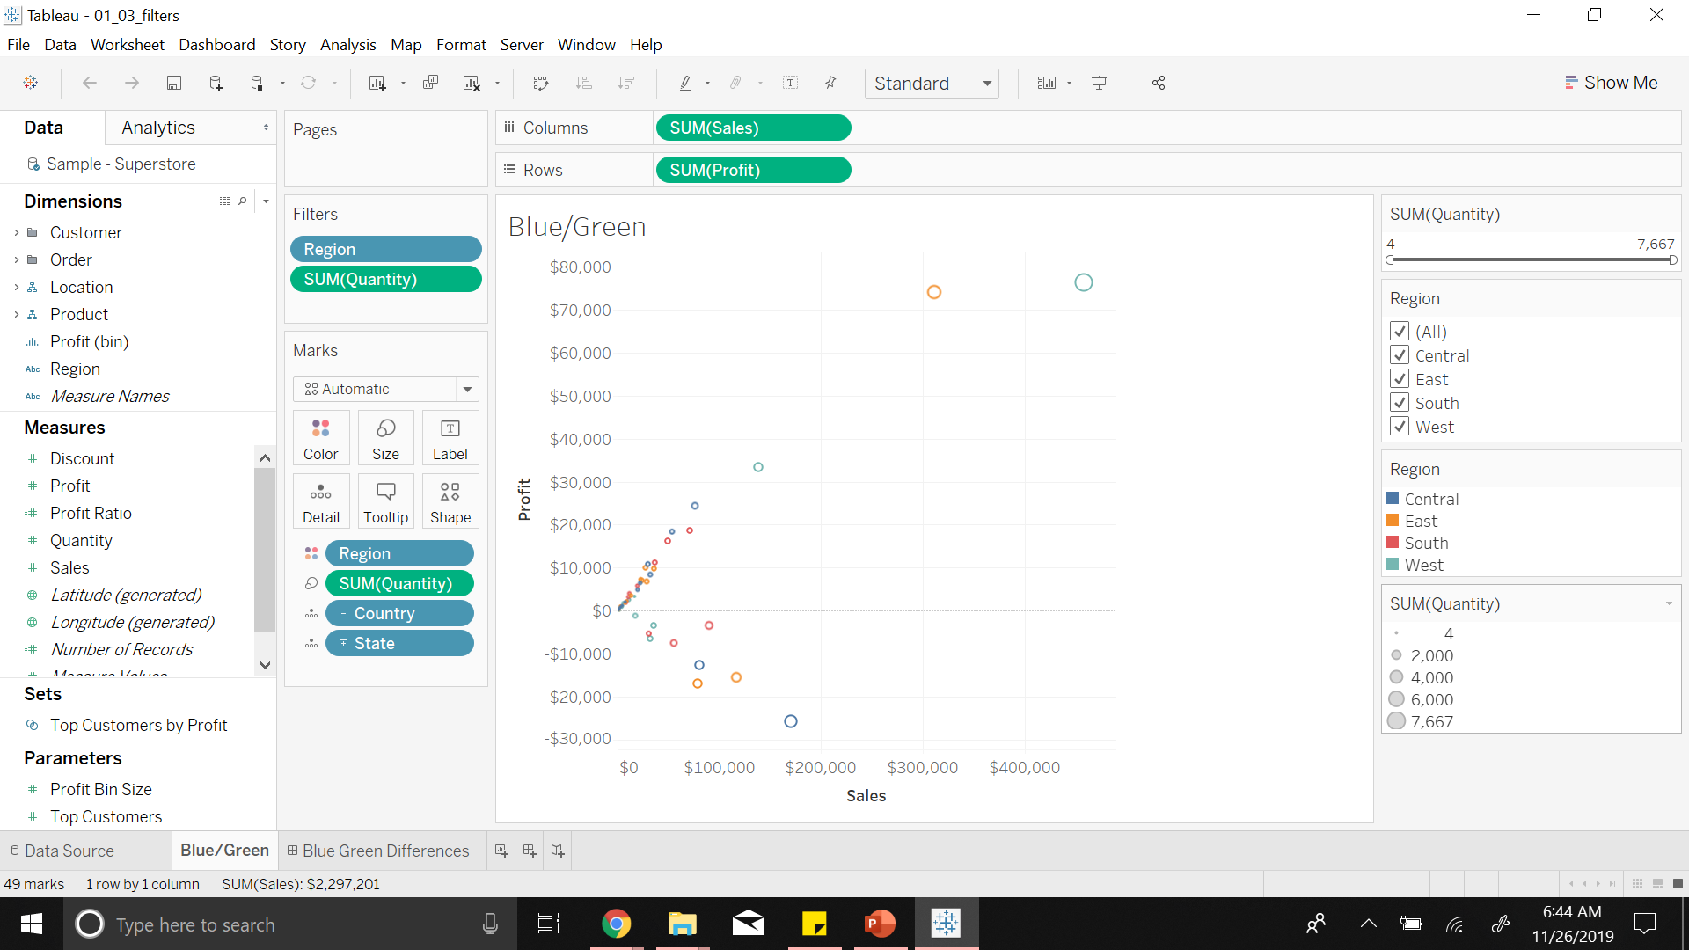
Notes:
Relationship b/n Sales and Profit for all the states
You can see Region and Quantity are put in filters tab
States are color coded by regions

Slide 28

Notes:
This connection for data can either be a live connection or an extract

Slide 29
3
Data
Data Extracts
Notes:
Live work directly on data
Data Extracts are local files that are optimized to enhance user experience and also when connection to datasource is slow

Slide 30

Notes:
.tde (tableau data extract file is generated on connected database)

Slide 31
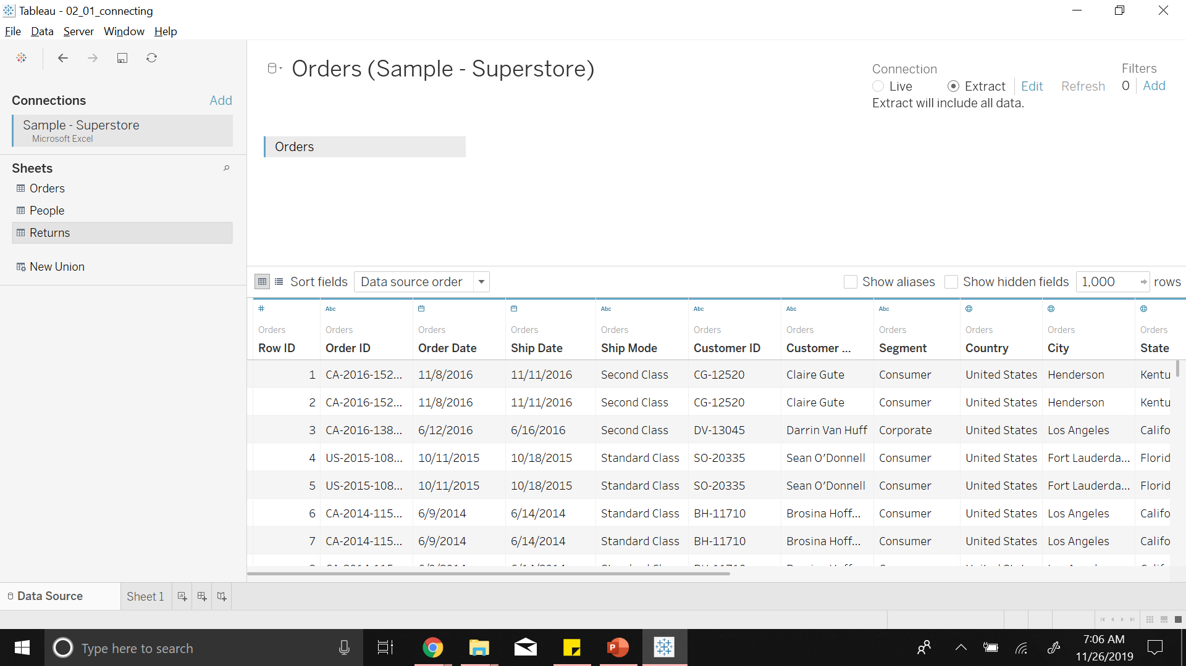
Notes:
After we connect data as extract we see two bins icon at the datasource connection

Slide 32
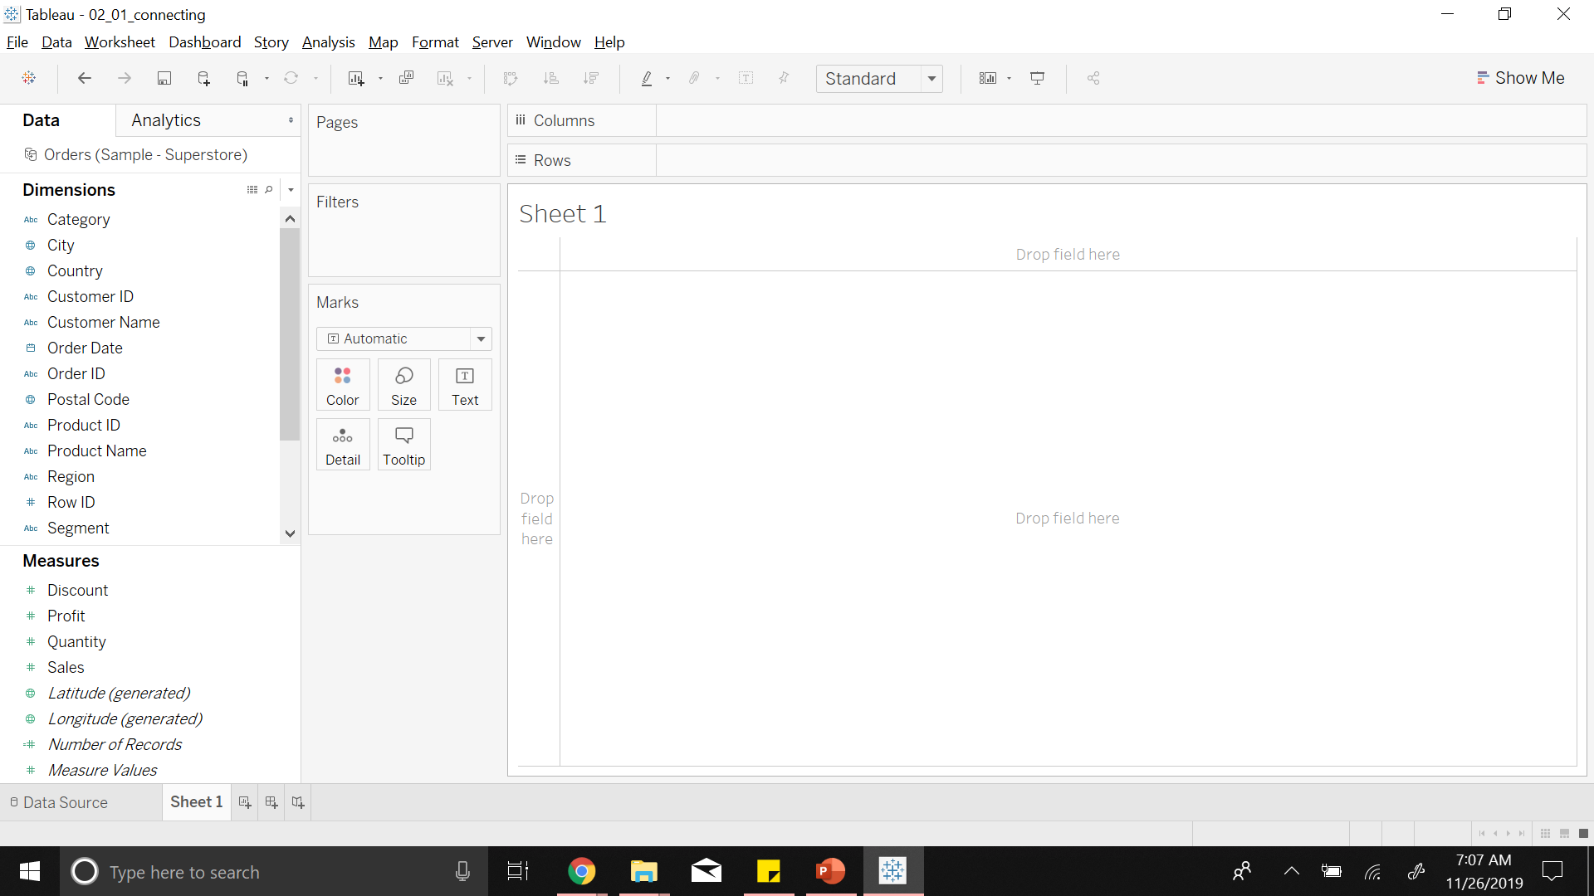
Notes:
So that represents an extract datasource (.tde file)

Slide 33
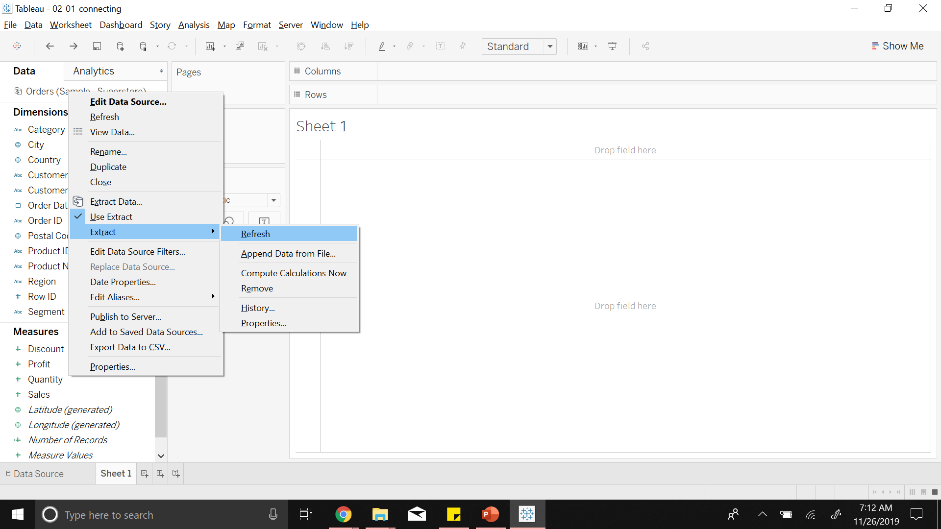
Notes:
Any changes made in the data source will not be reflected in the data extract
Hence, we refresh extract by doing so
We can use both extract and live data together to model out data analysis as shown here

Slide 34
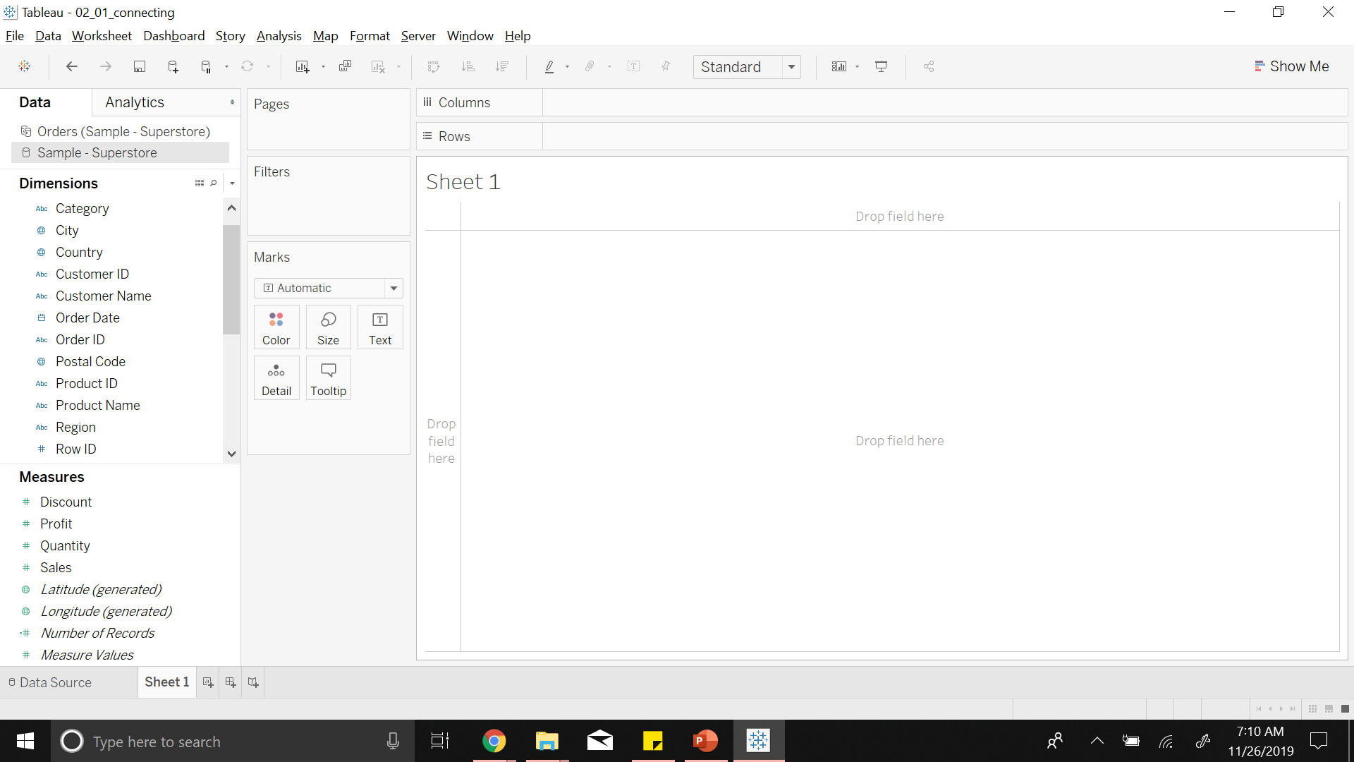
Notes:
This connected data can have null values, incorrect information or something that makes the quality of data very poor
Therefore it is necessary to transform the data

Slide 35
4
Data Transformations
Data Cleaning

Slide 36
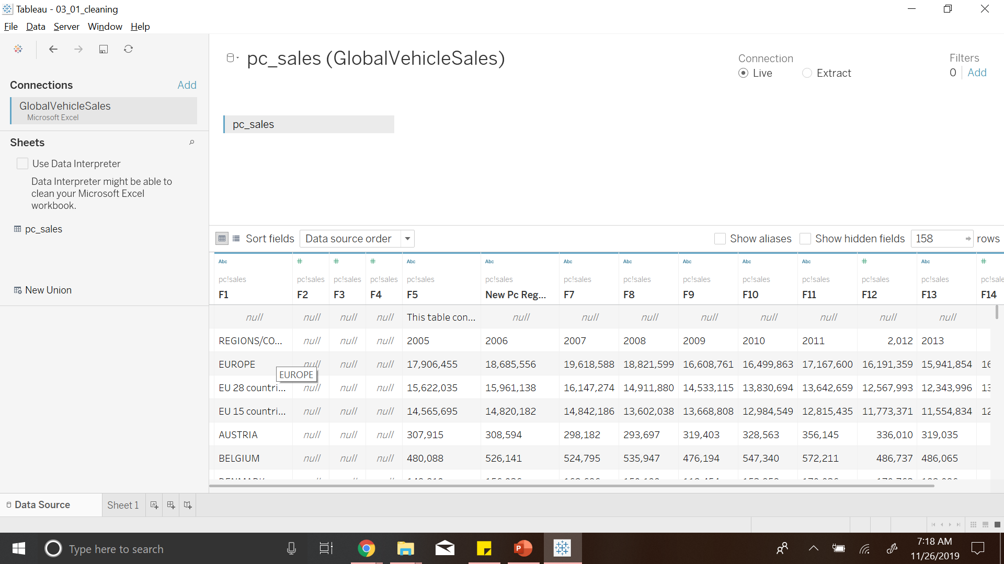
Notes:
We consider Global vehicle sales database, we see there are so many null values already
Tableau suggests a Data Interpreter to clean this NULL data as shown in the left

Slide 37
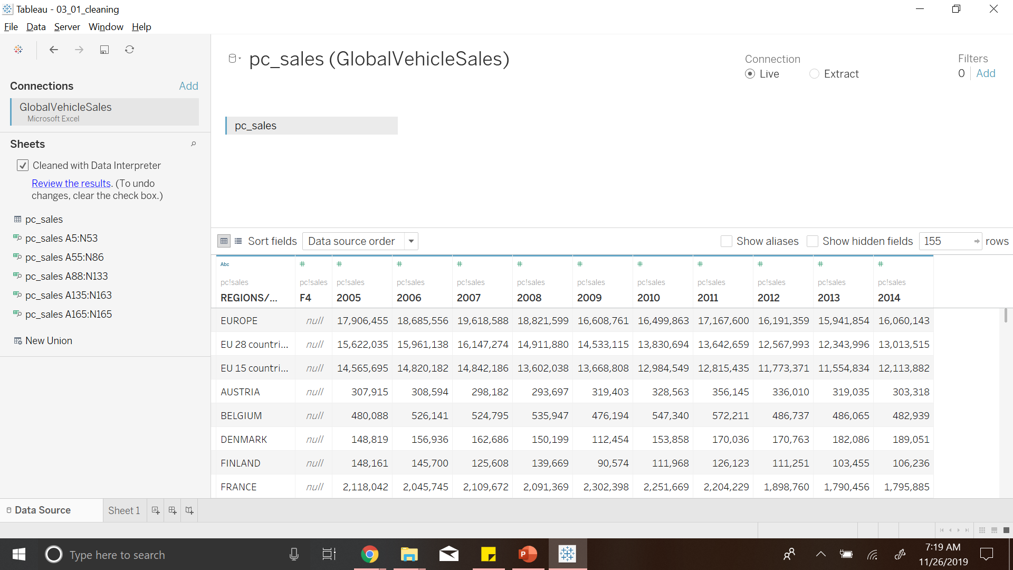
Notes:
Once cleaned we can review what tableau has done

Slide 38
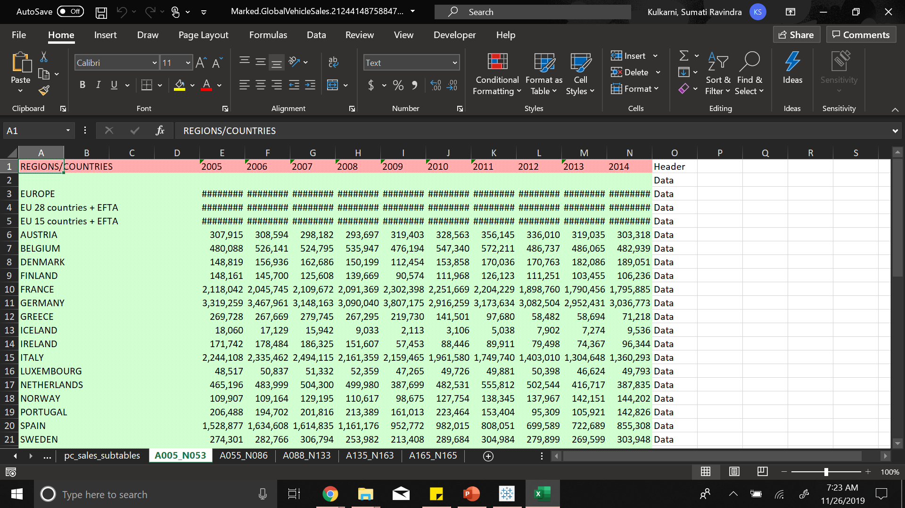
Notes:
It has marked the headers in red
Data in green
Sometimes due to bad data design, we might have to split the data that is present
Therefore data splitting

Slide 39
4
Data Transformations
Data Splitting

Slide 40
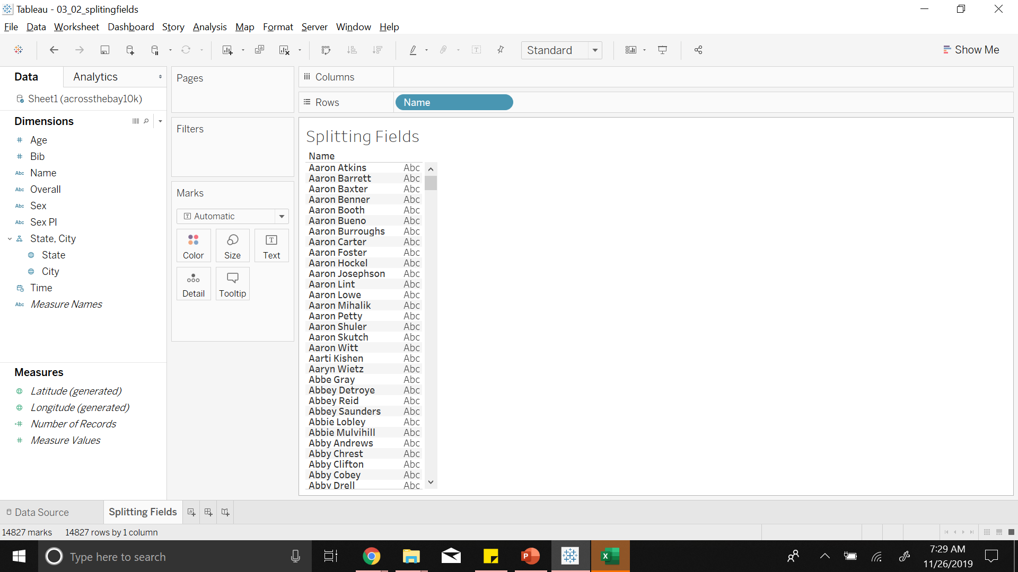
Notes:
We see the name having first name and last name in a single column

Slide 41
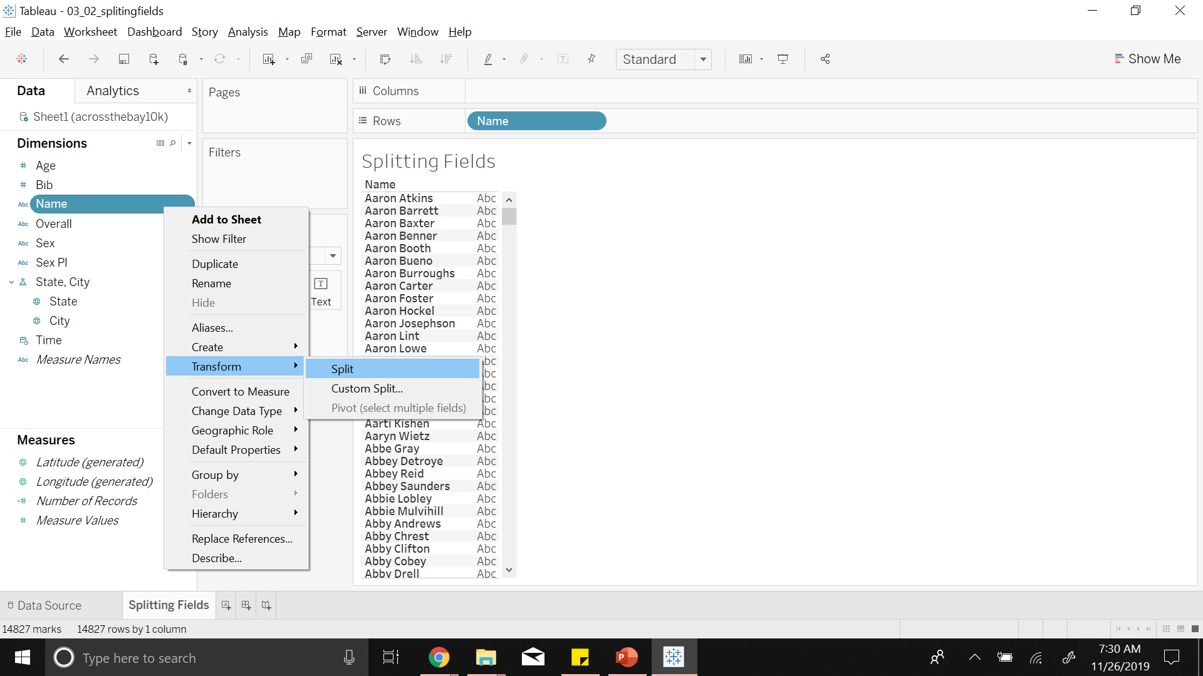
Notes:
Tableau has a transform function where we can split the data resp

Slide 42
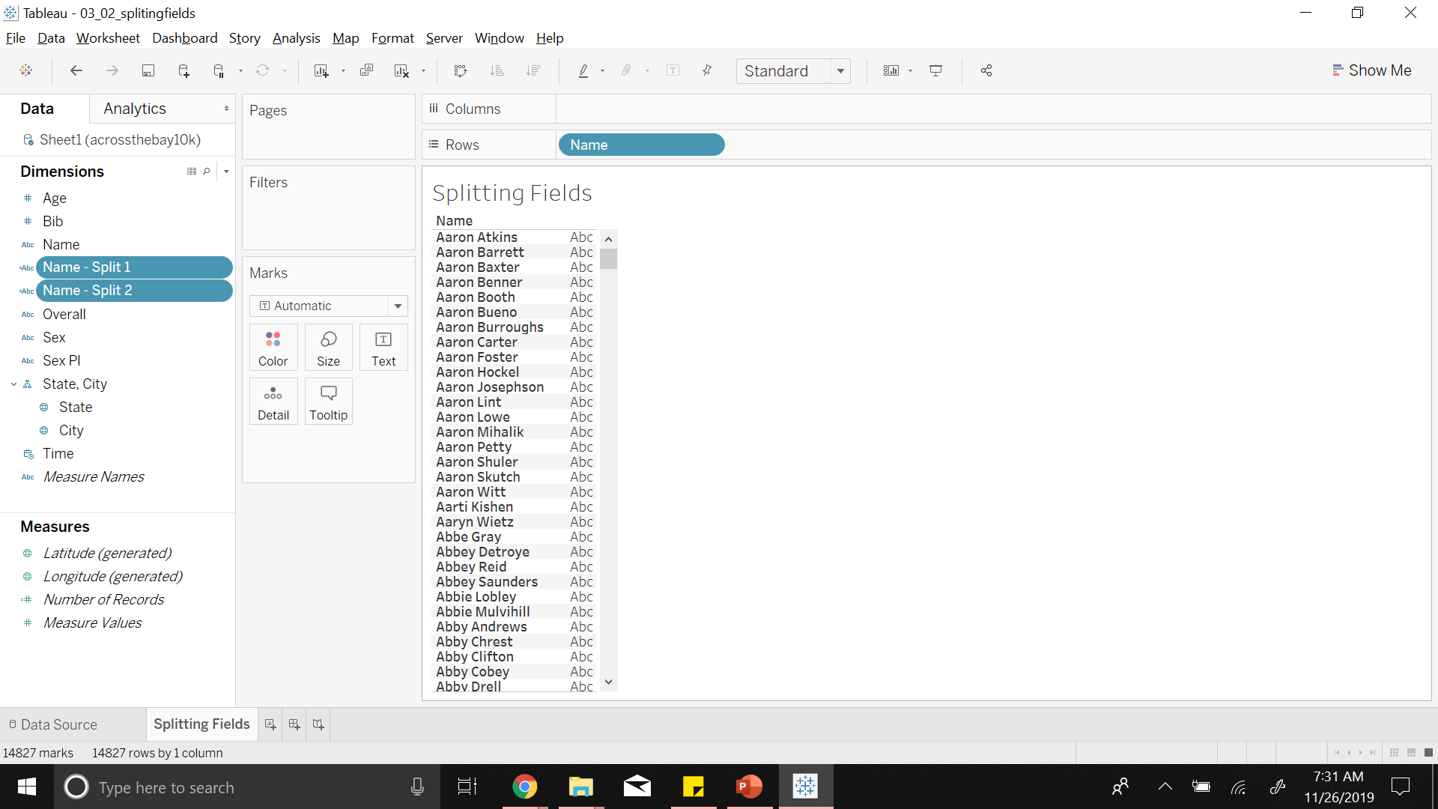

Slide 43
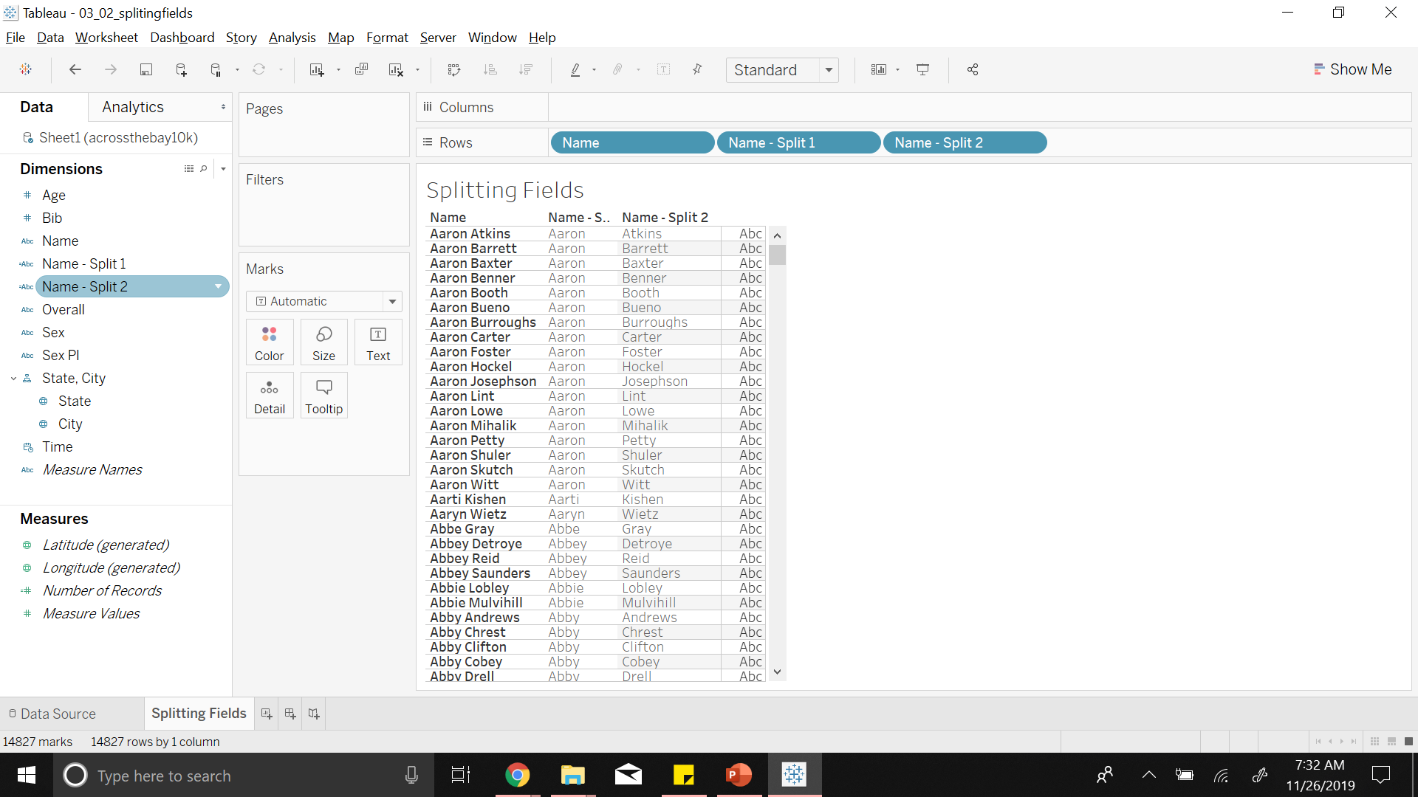
Notes:
We can rename the columns like so

Slide 44
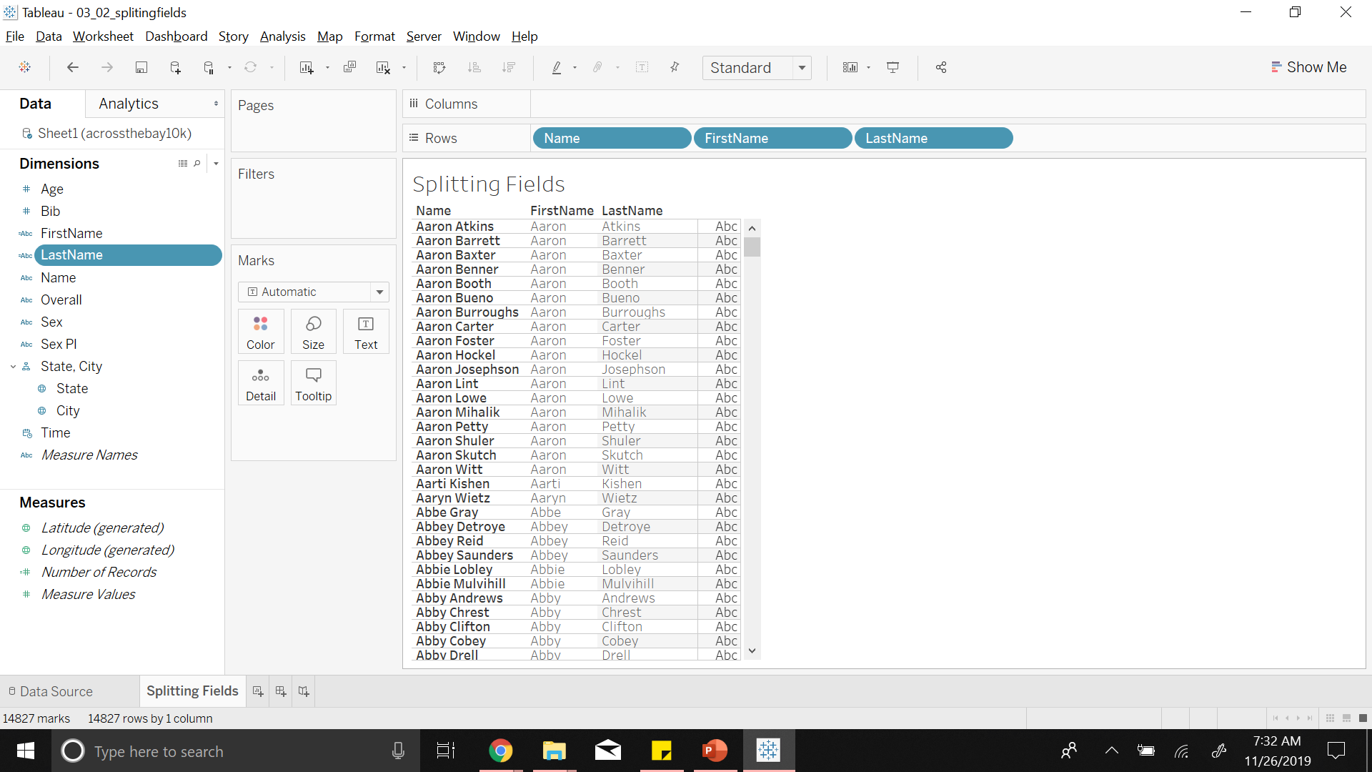
Notes:
We can also use this
If we have date
for splitting date into day month and year
Now we might have sales data for every year for all the regions in different columns and we might want to aggregate all sales data for the regions
Then comes data pivoting

Slide 45
4
Data Transformations
Data Pivoting

Slide 46
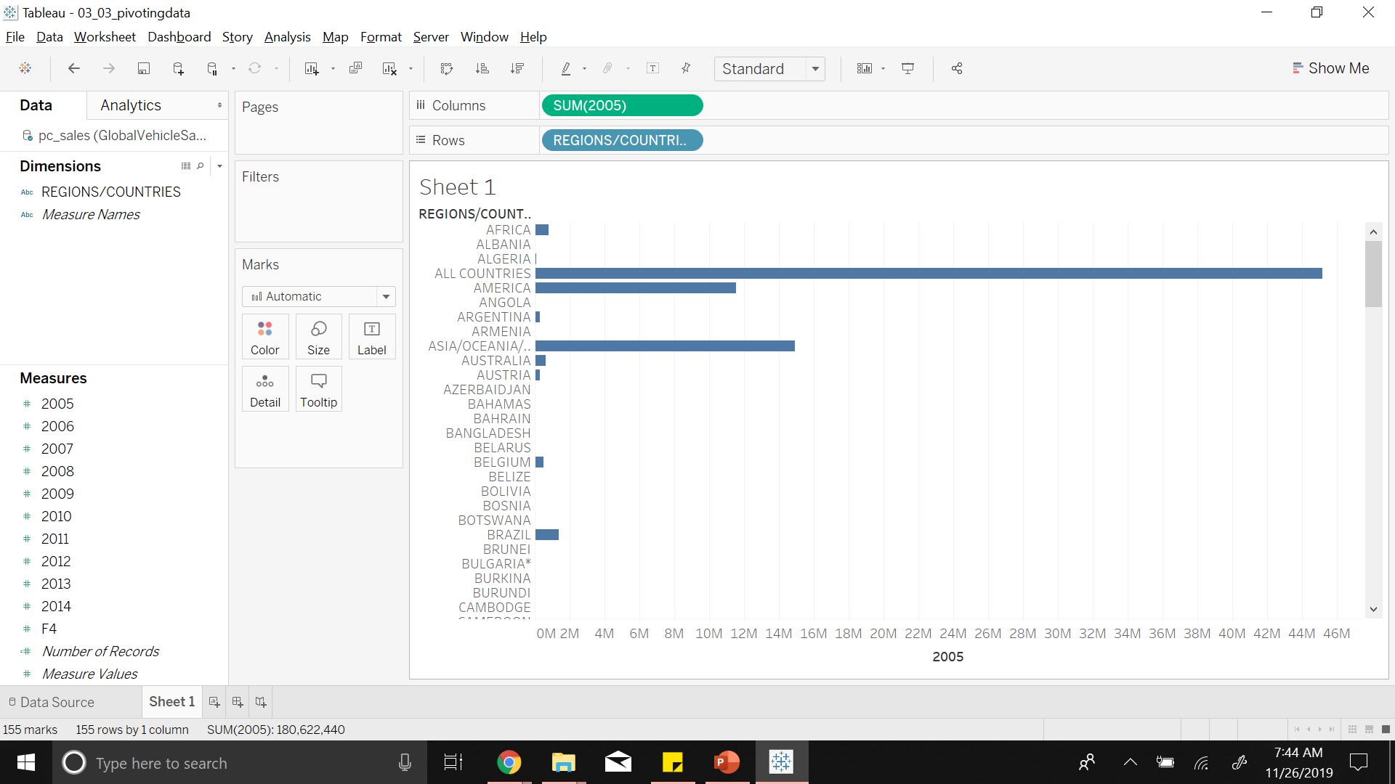
Notes:
Here we will look at Global Vehicle Sales data again
We have regions in one column
Sales for each year in separate column

Slide 47
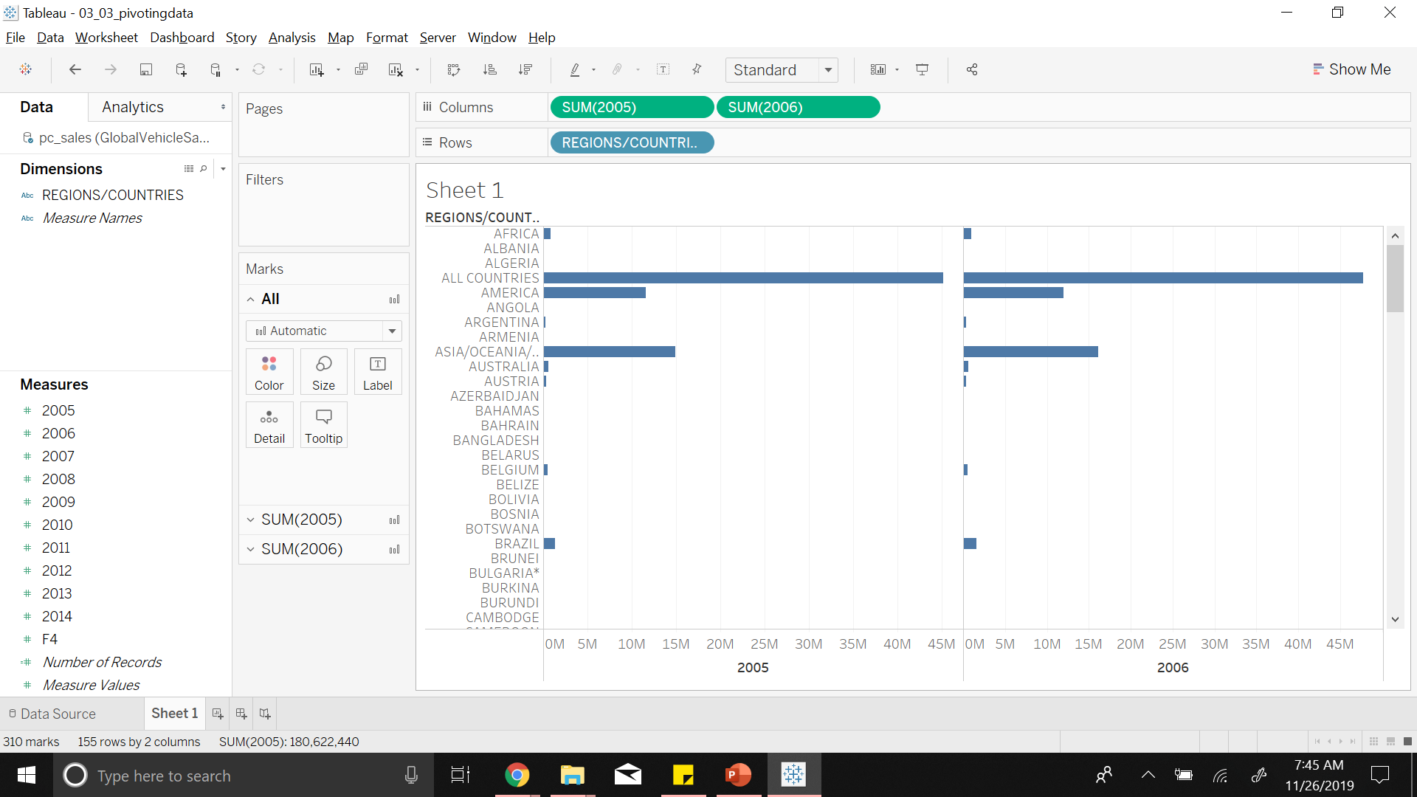
Notes:
And now its difficult to see any kind of trend or relationship between the years

Slide 48
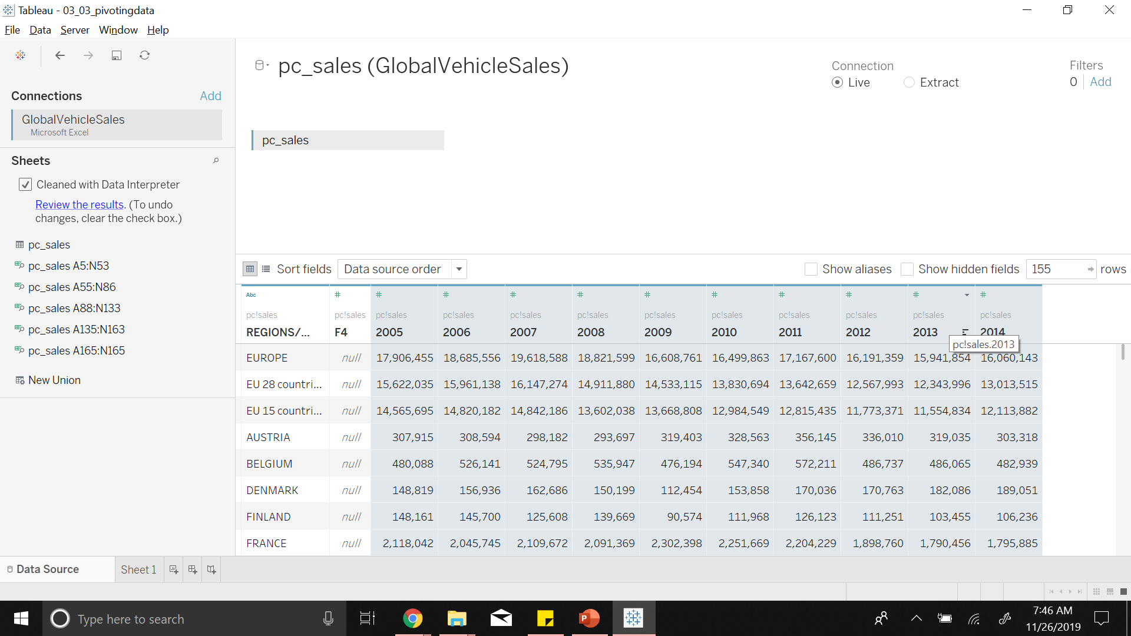
Notes:
Edit datasource
Right click and pivot data into single column and call it YEars

Slide 49
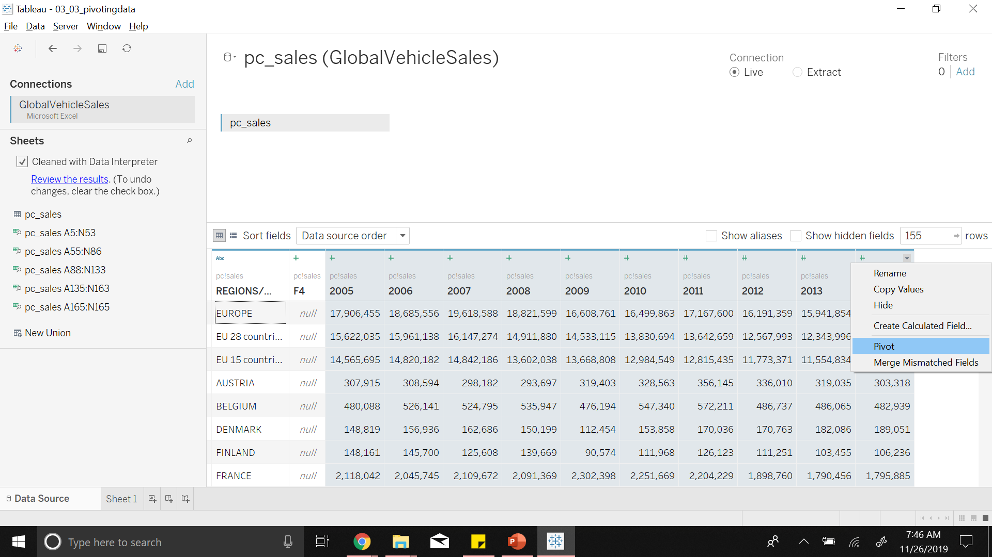

Slide 50
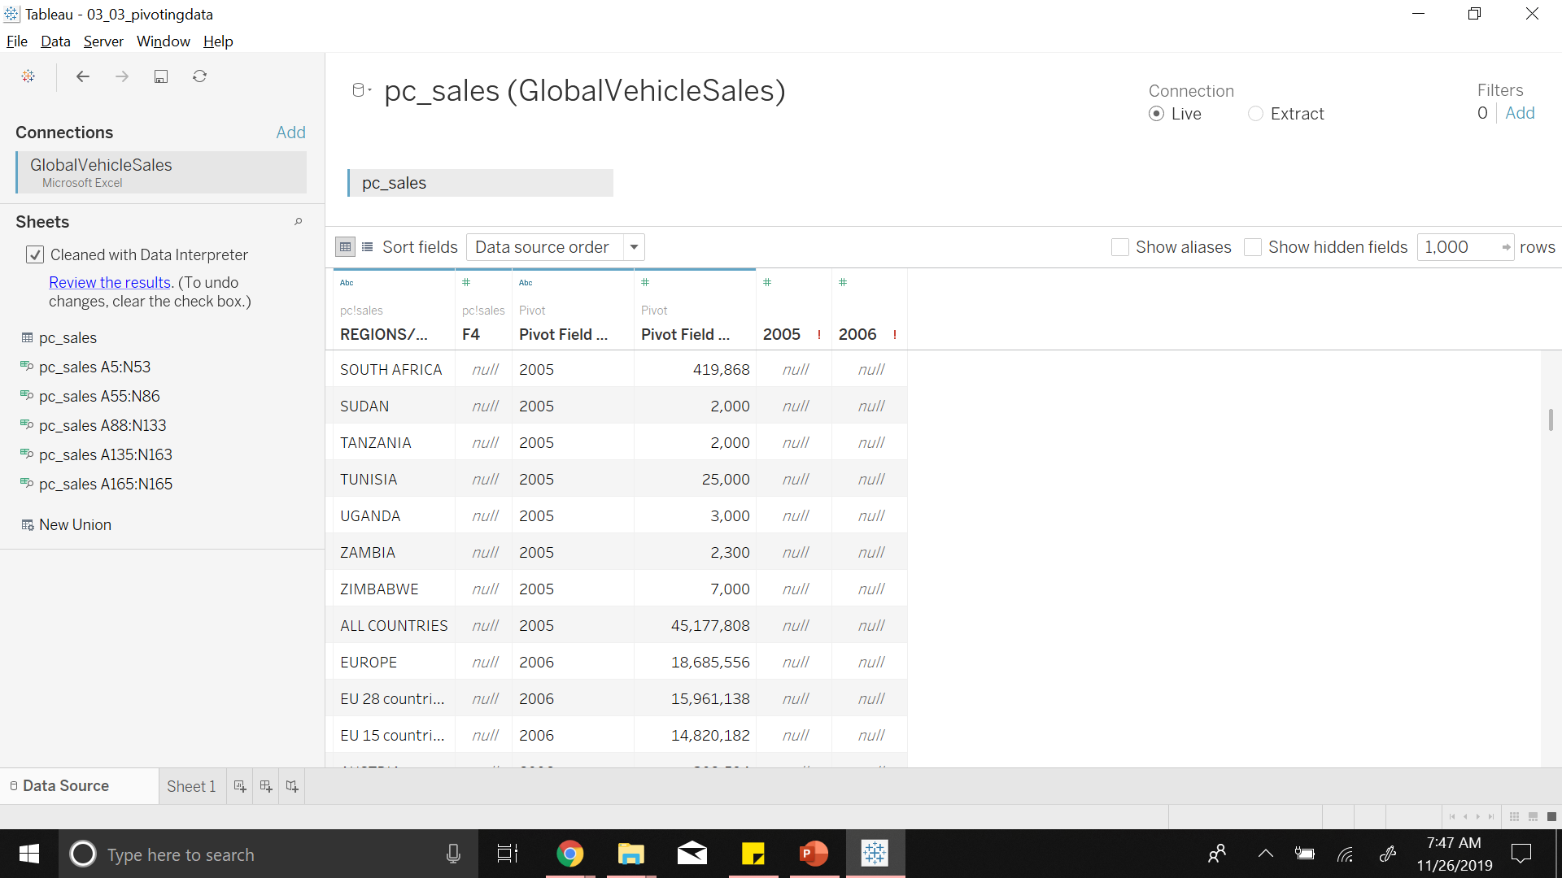
Notes:
We have two columns
Years
Sales
Rename them

Slide 51
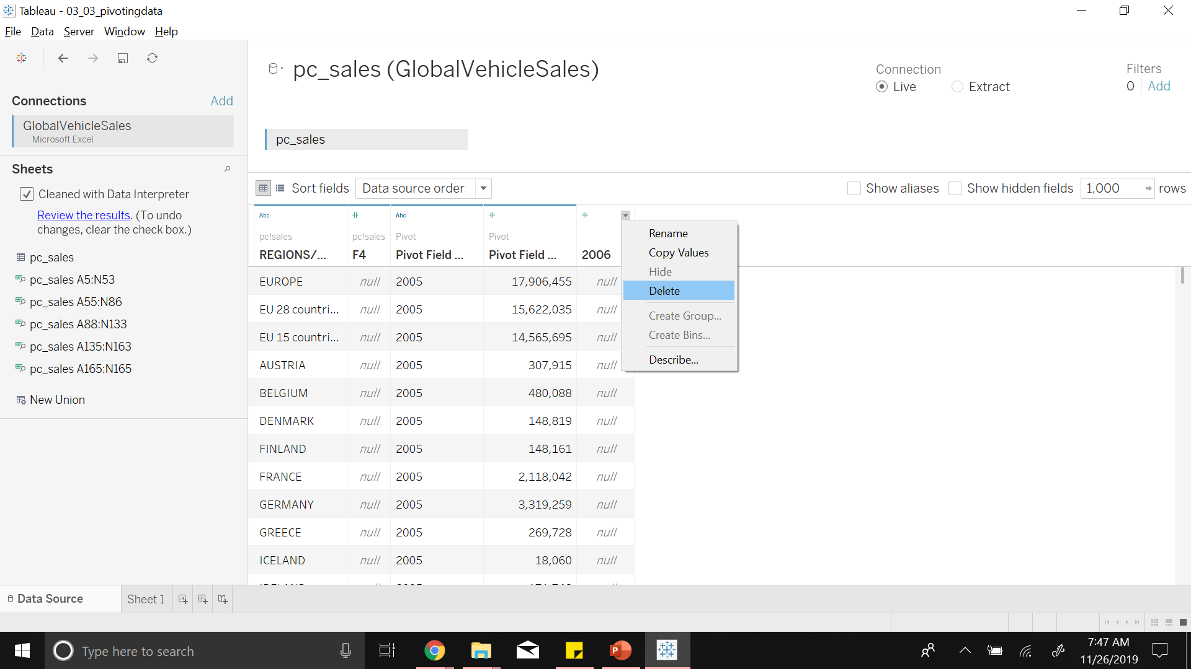
Notes:
Delete unwanted
Rename them as Years and Sales

Slide 52
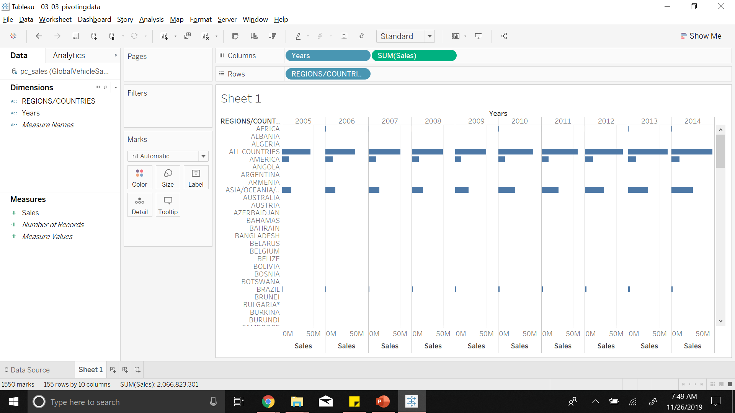
Notes:
We can see sales at different years and compare them

Slide 53
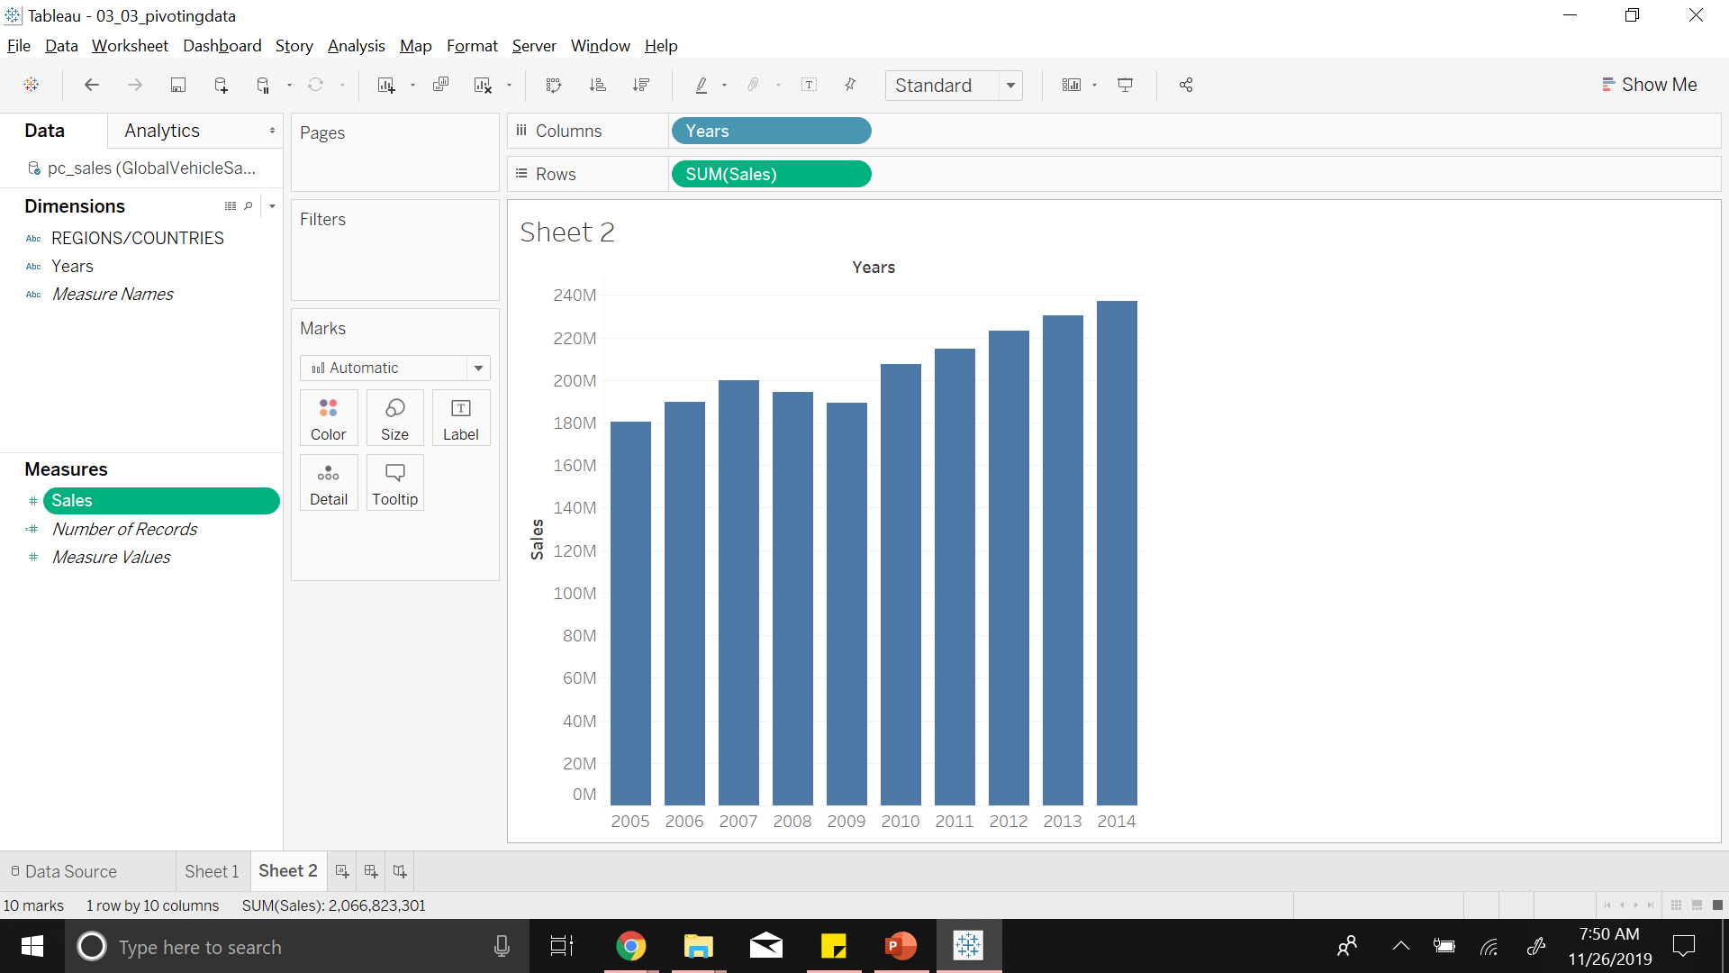
Notes:
Or have an aggregation of sales into bar chart which shows better trend

Slide 54

Notes:
We can convert this to line chart

Slide 55
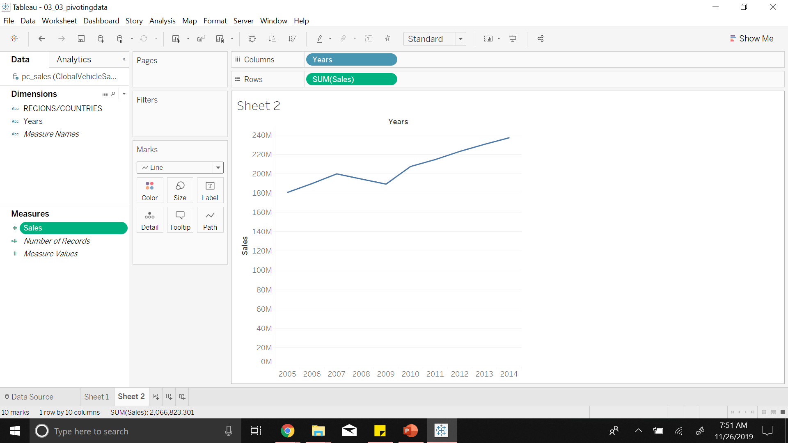
Notes:
And put regions into filter

Slide 56
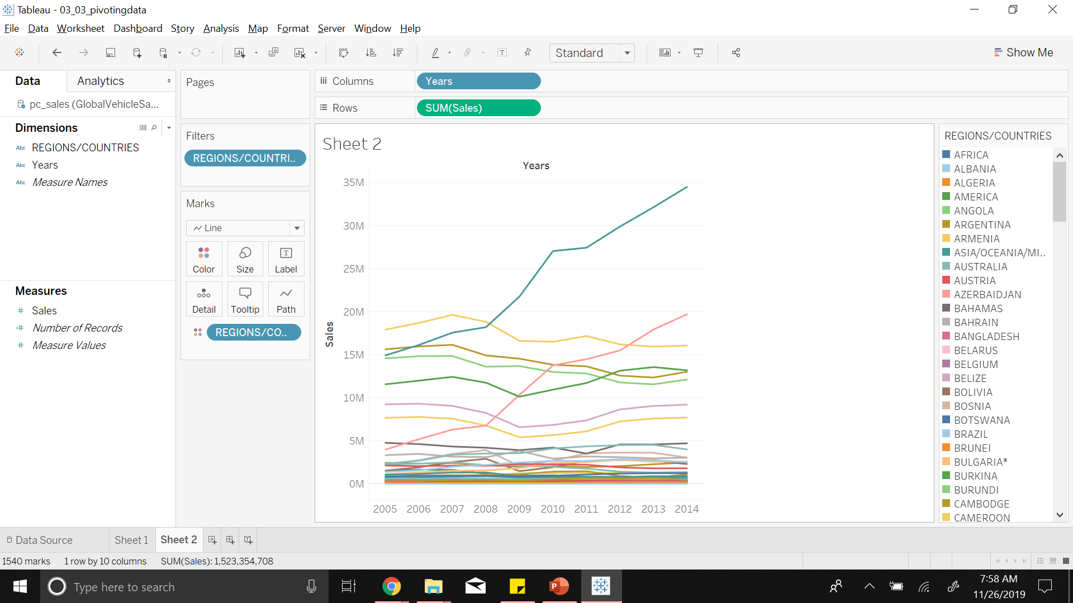
Notes:
Which gives us
Annual Sales for each country indicated by different color line
After seeing how to split data, we might want to do the opposite
That is merging the data

Slide 57
4
Data Transformations
Merging Data

Slide 58
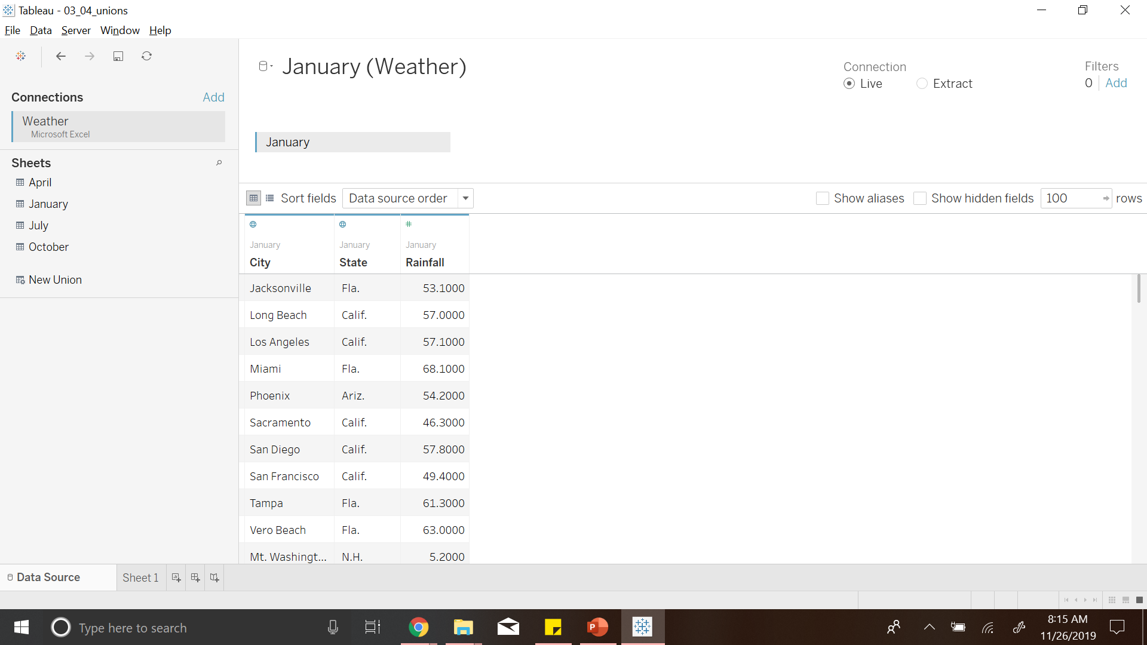
Notes:
Consider Weather data has 4 sheets of data
In real world this is more often that data is split into different sheets

Slide 59
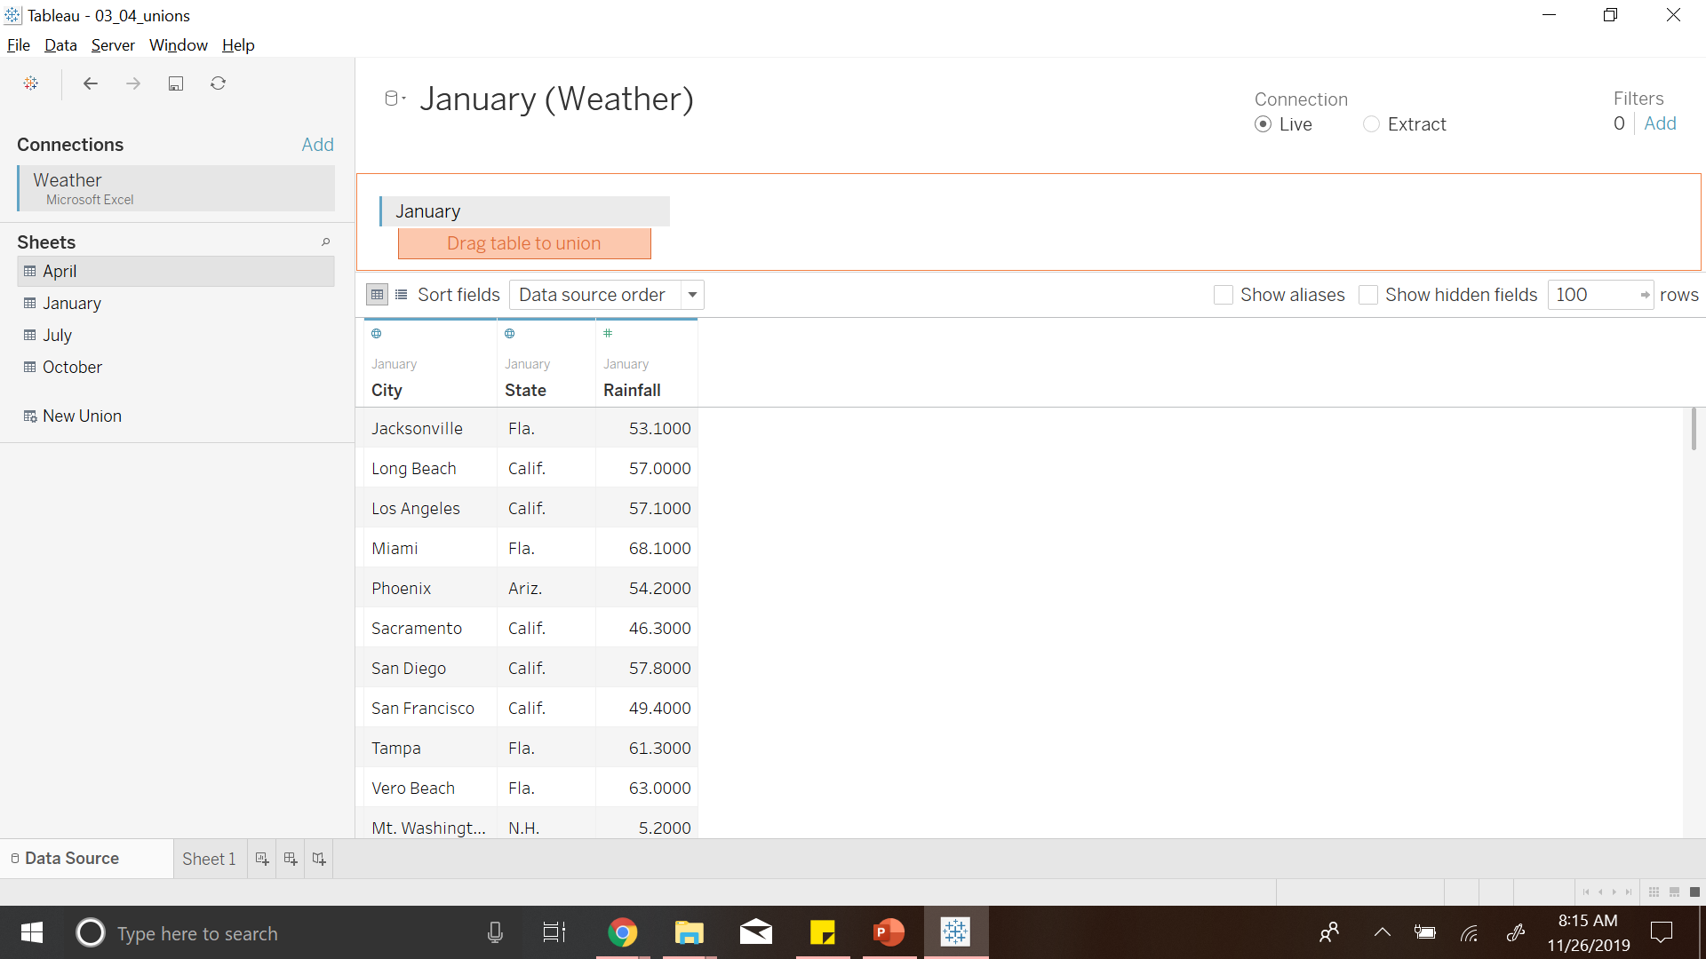
Notes:
Drag all sheets to the current sheet to merge or union them

Slide 60
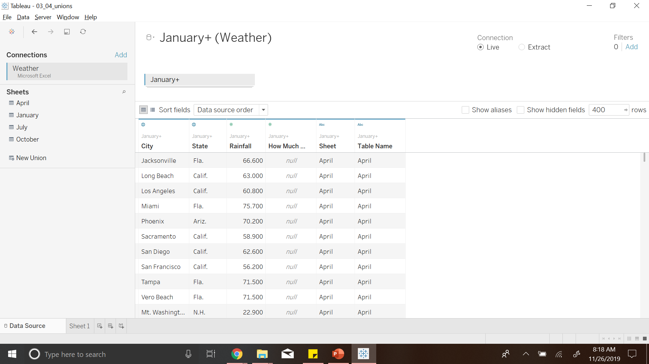
Notes:
We see there is a column name mismatch and most values are null

Slide 61
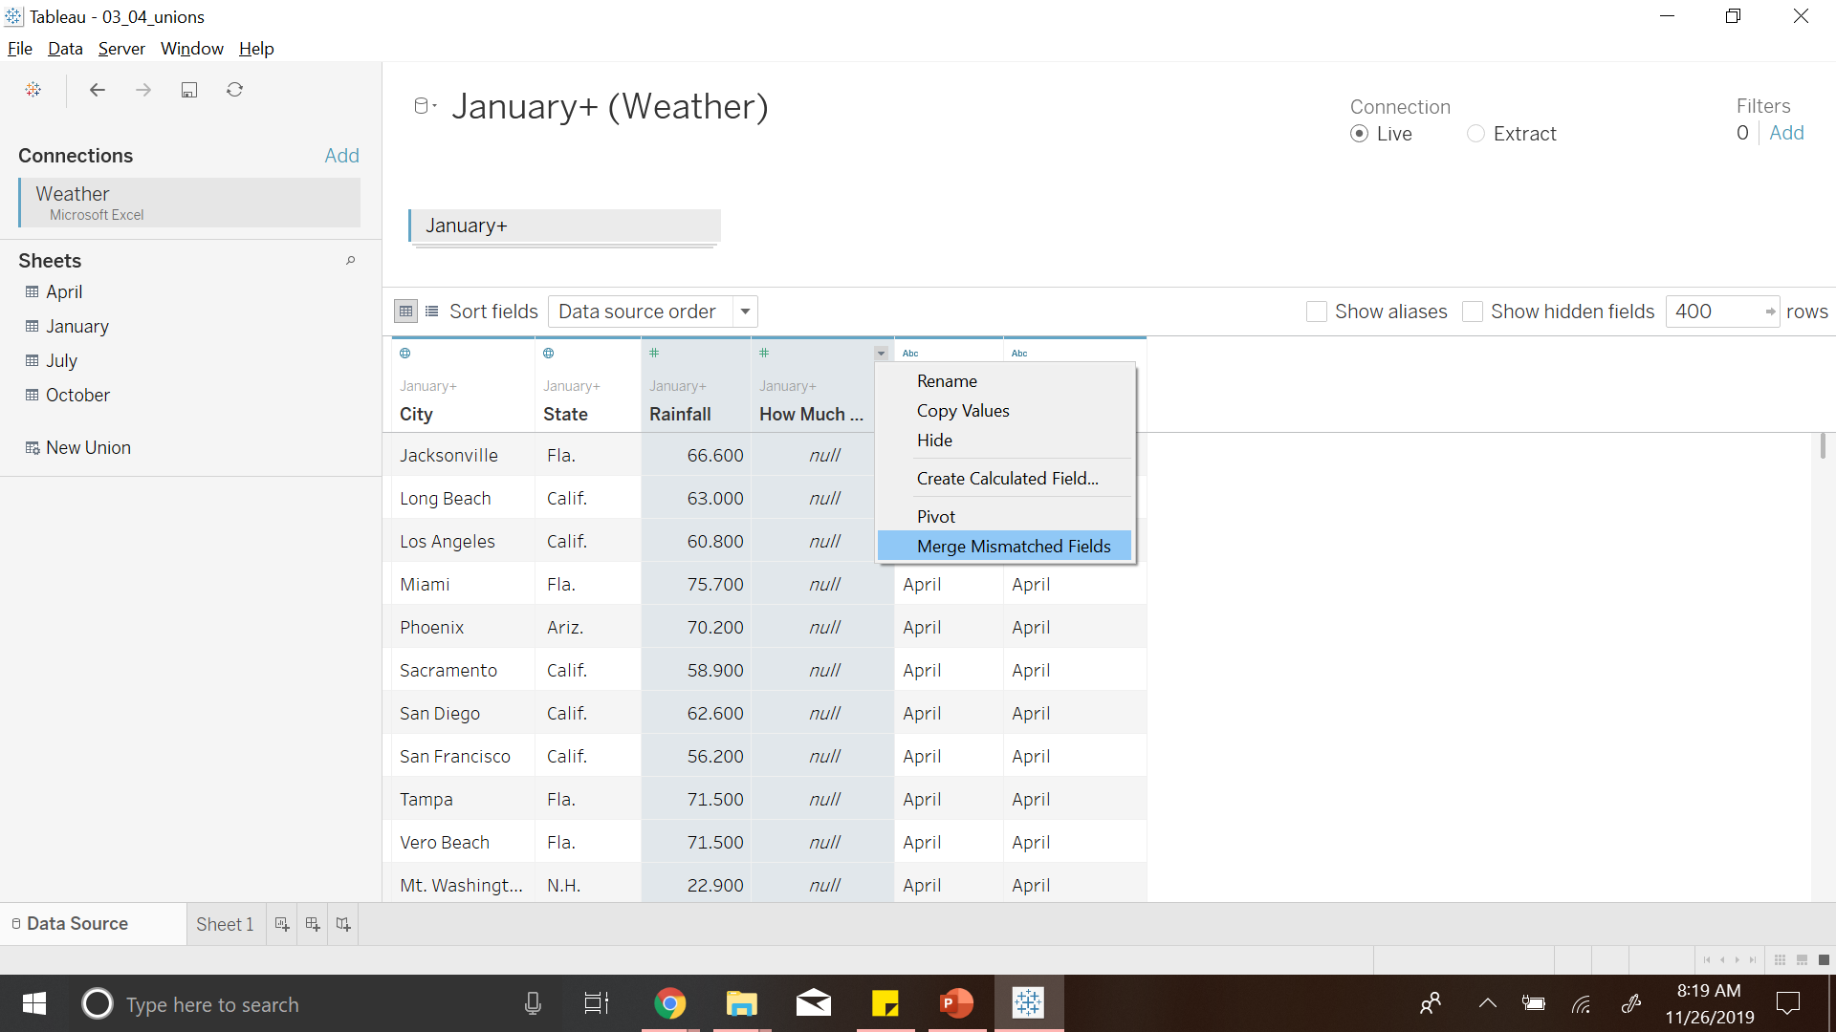
Notes:
Someone named the columns differently
Tableau retains them
We can merge as we know it’s the same data

Slide 62
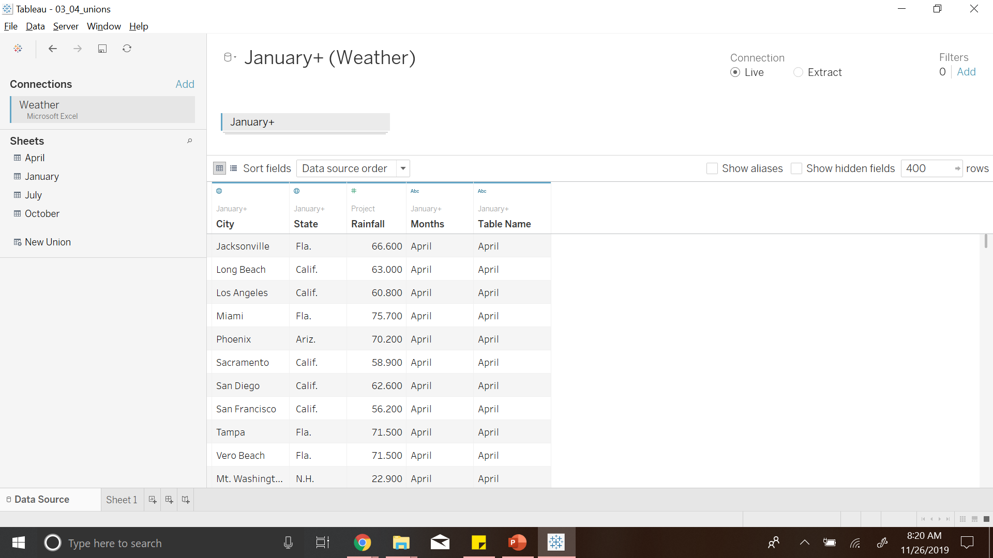

Slide 63
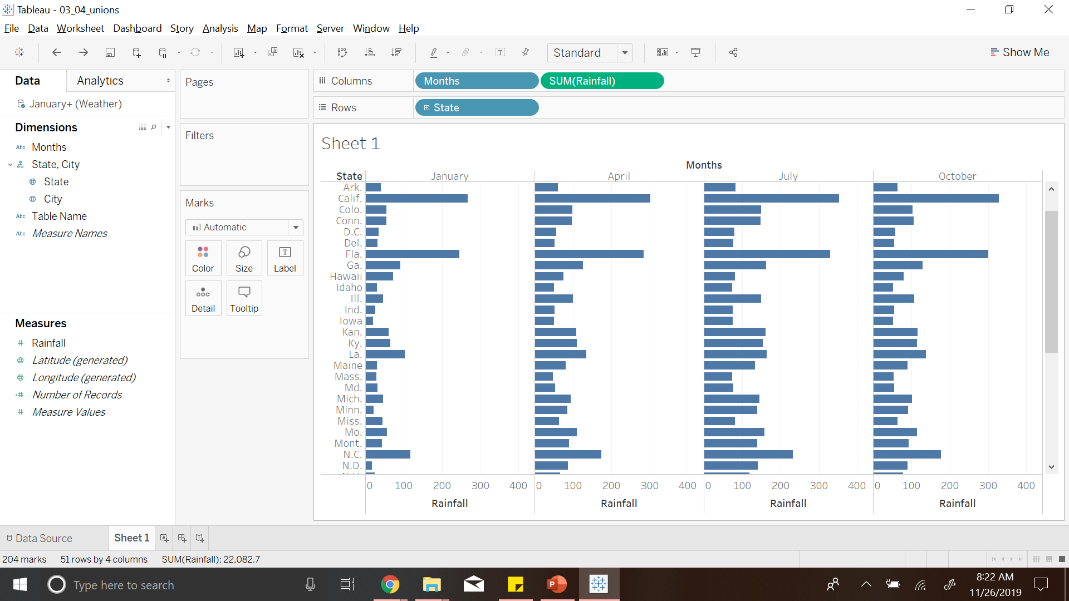
Notes:
We can see average rainfall throughout all regions for different months
Next we might want to integrate two same or different data sources. Then comes Cross DB Joins or Data Integration

Slide 64
4
Data Transformations
Cross DB joins / Data Integration
Notes:
Data transformations helps us to create unified data source where data can come from two different datasources

Slide 65
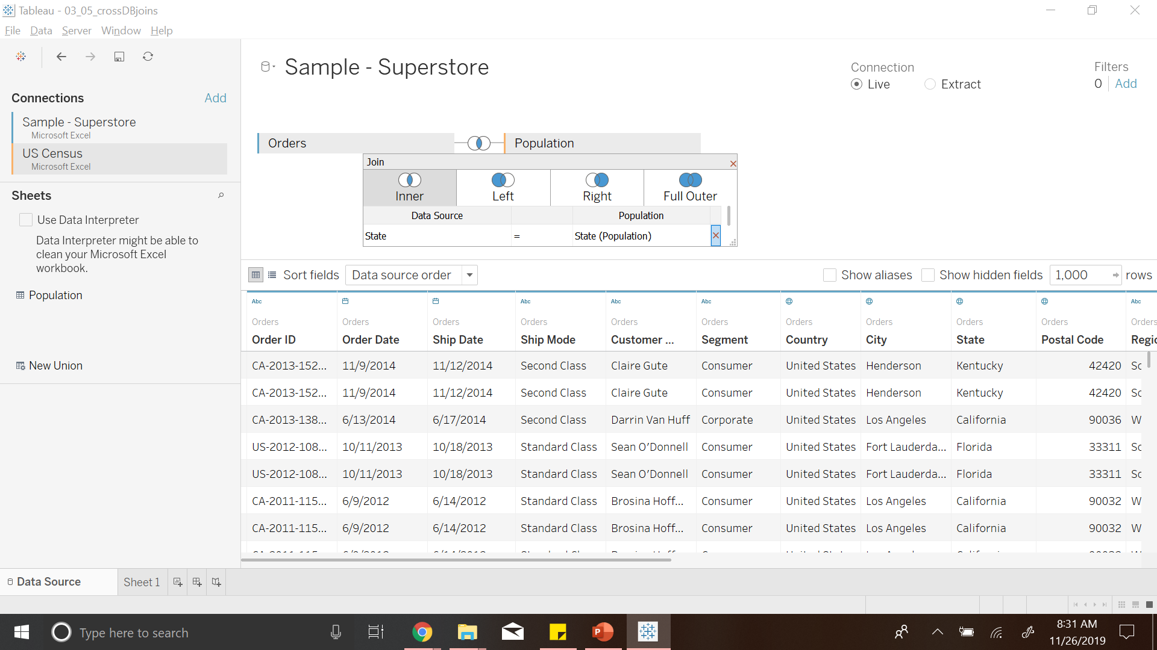
Notes:
We have Sales data across different regions
This data has not taken size of population into account
Therefore we bring Census info and join it (tableau performed inner join)
Now we see Population and sales

Slide 66
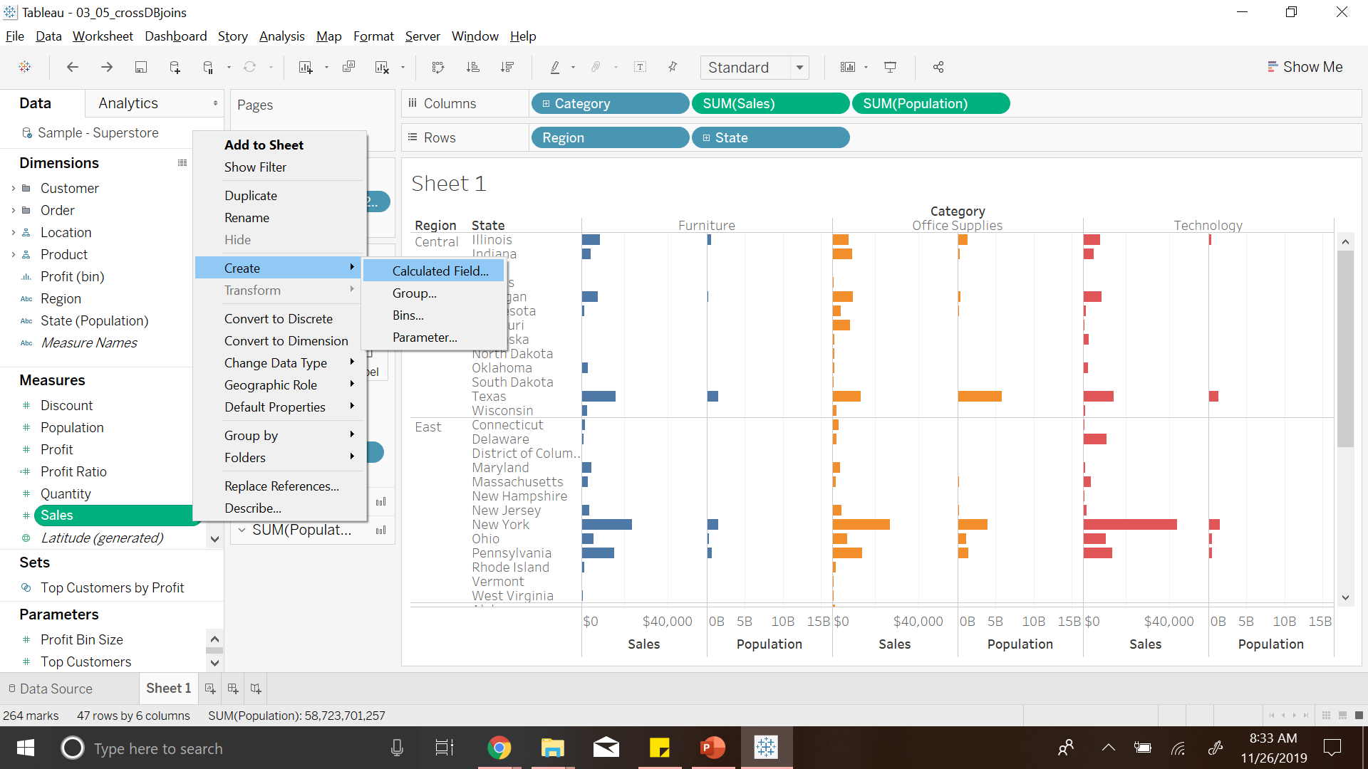
Notes:
We can add a calculated field Sales per capita

Slide 67
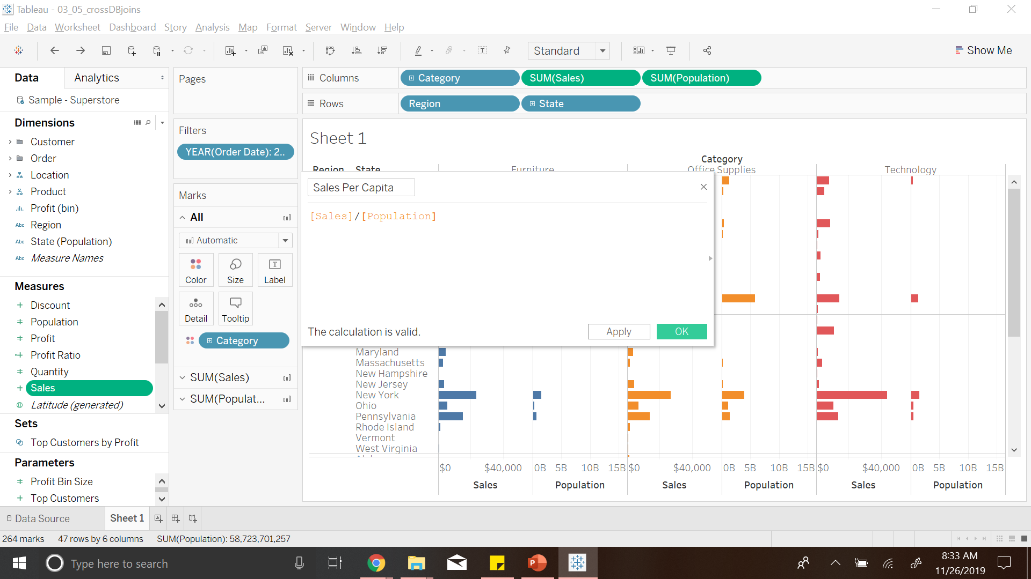

Slide 68
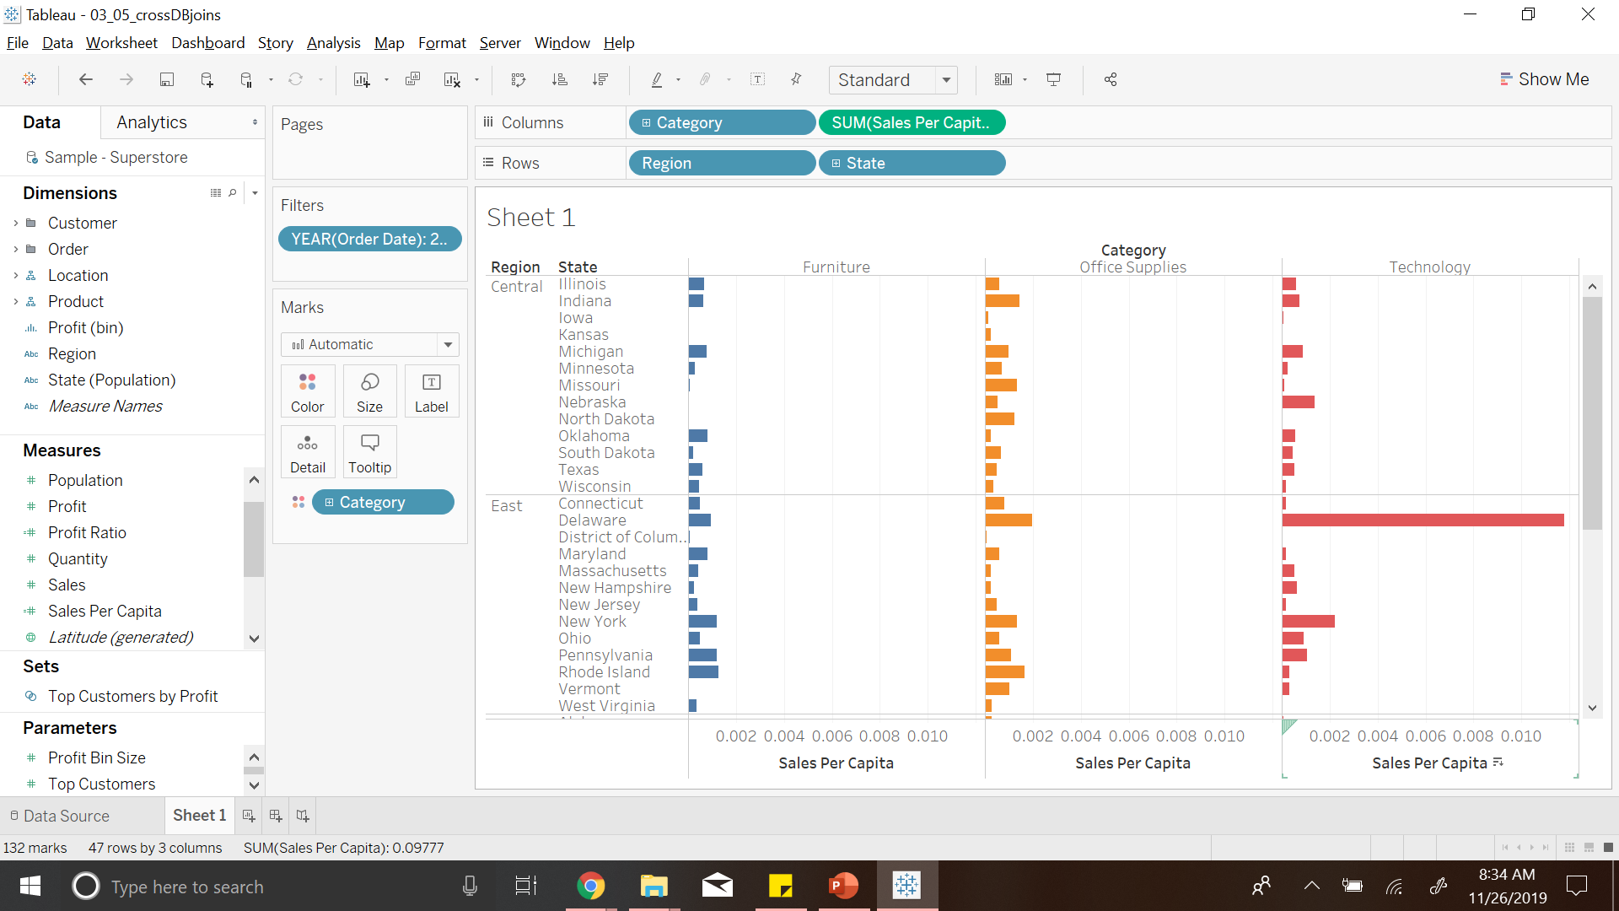
Notes:
This is the result of creating calculated field
Coming to Analyzing Data

Slide 69
5
Analytics
Notes:
Tableau provides a Analytics pane

Slide 70

Notes:
This shows Sales per category
Now if we want to know what is the average sales

Slide 71


Slide 72


Slide 73

Notes:
We can also see the linear trend line by dragging trend line model to the chart pane

Slide 74


Slide 75

Notes:
Now
If we want to know how things will be in future, we can add a forcasting

Slide 76


Slide 77

Notes:
Another useful technique is clustering
To identify some pattern in our data

Slide 78

Notes:
Here Tableau identifies there are three clusters in our data
Cluster 3 – outliers which are making high profits and large losses
These are probably the ones we want to investigate

Slide 79

Notes:
Tableau has the ability to filter data across two different data sources together.
Here you see these two graphs are coming from two different data sources

Slide 80

Notes:
If I filter left graph

Slide 81

Notes:
only population pane is reflected

Slide 82

Notes:
By applying the filter to all the worksheets we connect both the data

Slide 83

Notes:
We can see the sales graph reflects when we select a particular state on the left
Coming to mapping data on geographic pane using geographic data.

Slide 84
6
Mapping Data
Notes:
The main thing to think about here is
When should we map data?

Slide 85

Notes:
If data has geographic data into it, it doesn’t mean we should map data
Sales could be understood better with bar chart rather than mapping

Slide 86


Slide 87

Notes:
Coming to this data, showing CO2 emissions made by different countries
We can tell which is highest and the least, but cannot identify 2nd and 3rd by colors

Slide 88

Notes:
This makes more sense

Slide 89

Notes:
This map is showing average birth rate for all the countries.
We see higher birth rates across Africa

Slide 90

Notes:
We couldn’t have come to same conclusion if we mapped this data as a bar chart

Slide 91
6
Mapping Data
Creating new maps using MapBox

Slide 92

Notes:
Tableau has some map formatting options to make map look attractive.
Map Layers

Slide 93

Notes:
Here we can change look and feel of the map
However the options are quite limited
If we want to get more detailed maps, we can provide a new map as input to tableau
I will be demonstrating this with mapbox.com maps

Slide 94


Slide 95


Slide 96


Slide 97


Slide 98


Slide 99


Slide 100


Slide 101


Slide 102


Slide 103

A NOTE ON FILE TYPES
Workbook (.twb): Workbooks hold worksheets, dashboards and stories.
Bookmark (.tbm): Bookmarks contain a single sheet.
Packaged workbook (.twbx): Archive containing a workbook along with all data sources and files.
Data extract (.tde): Local copy of a subset or entire data source to share and improve the performance.
Data source(.tds): Shortcut to oftenly used data sources, containing information and modifications.
Packaged data source (.tdsx): Archive containing a data source file along with any related files.

Slide 104
THANKS!
Any questions?

